Slide 1
Review
Boxi Wu / Xiaofei He
Zhejiang University

Slide 2
Example: Convert 135₁₀ To Base 2
(135)10 = (1000 0111)2
2 1 3 5
2 6 7…………1
2 3 3…………1
2 1 6…………1
2 8…………0
2 4…………0
2 2…………0
2 1…………0
2 0…………1

Slide 3
Example: Convert 0.6875₁₀ To Base 2
(0.6875)10 = (0.1011)2
2× 0.6875………… = 1.375
2× 0.375………… = 0.75
2× 0.75………… = 1.5
2× 0.5………… = 1

Slide 4
sign-and-magnitude (原码)
A positive number and the corresponding negative number share the same value part
  The conversion between the original code and true value is straightforward, i.e., just alter the sign bit
The coding rules are as follows:
  X_{T} > 0, X_{n-1} = 0, X_{i} = X_{i}’ (0≤i ≤ n-2)
  X_{T} < 0, X_{n-1} = 1, X_{i} = X_{i}’ (0≤i ≤ n-2)
There are two ways to represent 0!
Notes:
原码表示由符号位后直接跟数值位构成，又称为符号-数值表示法。
[+0] = 0 000…0
[-0] = 1 000…0
True value: -10
Machine number: -1010B -> 10001010B
缺点：1）0不唯一；2）符号和数值部分必须分开处理。

Slide 5
Binary 1's Complement(反码)
For r = 2, N = 01110011₂, n = 8 (8 digits):
(r^{n} – 1) = 256 -1 = 255₁₀ or 11111111₂
The 1's complement of 01110011₂ is then:
11111111
– 01110011
10001100
Since the 2^{n} – 1 factor consists of all 1's and since 1 – 0 = 1 and 1 – 1 = 0, the one's complement is obtained by complementing each individual bit (bitwise NOT).

Slide 6
Binary 2's Complement(补码)
For r = 2, N = 01110011₂, n = 8 (8 digits), we have:
(r^{n} ) = 256₁₀ or 100000000₂
The 2's complement of 01110011 is then:
100000000
– 01110011
10001101
Note the result is the 1's complement plus 1, a fact that can be used in designing hardware

Slide 7
Alternate 2’s Complement Method
Given: an n-bit binary number, beginning at the least significant bit and proceeding upward:
  Copy all least significant 0’s
  Copy the first 1
  Complement all bits thereafter.
2’s Complement Example:
  10010100
  Copy underlined bits:
  100
  and complement bits to the left:
  01101100

Slide 8
Signed and Unsigned Numbers
Possible Representations
Sign Magnitude One's Complement Two's Complement
000 = +0 000 = +0 000 = +0
001 = +1 001 = +1 001 = +1
010 = +2 010 = +2 010 = +2
011 = +3 011 = +3 011 = +3
100 = -0 100 = -3 100 = -4
101 = -1 101 = -2 101 = -3
110 = -2 110 = -1 110 = -2
111 = -3 111 = -0 111 = -1
Which one is best? Why?
  Issues: number of zeros, ease of operations

Slide 9
More common: use of 2's complement
---- negatives have one additional number
  (0000 0000 0000 0000 0000 0000 0000 0000)₂ =(0)₁₀
  (0000 0000 0000 0000 0000 0000 0000 0001)₂ =(1)₁₀
  ………… ………
  (0111 1111 1111 1111 1111 1111 1111 1101)₂ =( 2，147，483，645)₁₀
  (0111 1111 1111 1111 1111 1111 1111 1110)₂ =( 2，147，483，646)₁₀
  (0111 1111 1111 1111 1111 1111 1111 1111)₂ =( 2，147，483，647)₁₀
  (1000 0000 0000 0000 0000 0000 0000 0000)₂ =(-2，147，483，648)₁₀
  (1000 0000 0000 0000 0000 0000 0000 0001)₂ =(-2，147，483，647)₁₀
  (1000 0000 0000 0000 0000 0000 0000 0010)₂ =(-2，147，483，646)₁₀
  ………… ………
  (1111 1111 1111 1111 1111 1111 1111 1101)₂ =(-3)₁₀
  (1111 1111 1111 1111 1111 1111 1111 1110)₂ =(-2)₁₀
  (1111 1111 1111 1111 1111 1111 1111 1111)₂ =(-1)₁₀
Notes:
-1就是全1，最大的负数是100000.。。000

Slide 10
sign extension
Expansion
e.g. 8 bit numbers to 64/32 bit numbers
Required for operations with registers(32/64 bits) and immediate operands (8 bits)
Sign extension
  Take the lower 8 bits as they are
  Copy the highest bit to the remaining 24/56 bits
  0000 0010 → 2
  0000 0000 0000 0000 0000 0000 0000 0010
  1111 1110 → -2
  1111 1111 1111 1111 1111 1111 1111 1110
Notes:
字节装入，lb（signed）, lbu (unsigned)，一般字节都是处理字符，几乎全是lbu

Slide 11
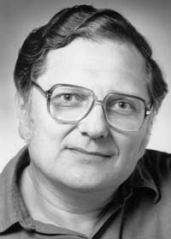
IEEE Floating Point
Carnegie Mellon
IEEE Standard 754
  Designed by William Kahan since 1976
  Established in 1985 as uniform standard for floating point arithmetic
    Before that, many idiosyncratic formats
  Supported by all major CPUs
Driven by numerical concerns
  Nice standards for rounding, overflow, underflow
  Hard to make fast in hardware
    Numerical analysts predominated over hardware designers in defining standard
Notes:
IEEE 标准 754
William Kahan 从1976年开始为Intel 设计(1989获图灵奖)
1985年成为浮点运算的统一标准，快速, 易于实现、精度损失小
优雅、易理解
所有主流的CPU都支持
之前有很多不同格式、不太关注精确性

Slide 12
Frameshift Code (移码)
Be used to represent the exponent part of a floating-point number
A floating-point number is represented by two fixed-point numbers with a sign bit
  A fixed-point decimal is used to represent the significand of the floating-point number
  A fixed-point integer is used to represent the order of power of two of the floating-point number
Will discuss it later
s | exp | frac

Slide 13
Floating Point Representation
Carnegie Mellon
Numerical Form:
(–1)^{s} M 2E
  Sign bit s determines whether number is negative or positive
  Significand M normally a fractional value in range [1.0,2.0).
  Exponent E weights value by power of two
s | exp | frac
S: sign bit (0 ⇒ non-negative, 1 ⇒ negative)
Normalize significand: 1.0 ≤ |significand| < 2.0
  Always has a leading pre-binary-point 1 bit, so no need to represent it explicitly (hidden bit)
  Significand is Fraction with the “1.” restored
Exponent: excess representation: actual exponent + Bias
  Ensures exponent is unsigned
  Single: Bias = 127; Double: Bias = 1023
Notes:
符号(sign)s， 决定数的符号，是正数(s=0)或负数(s=1)
尾数(Significand) M，二进制小数，数值范围: [1.0,2.0)
阶码(Exponent) E ，用2E将数值加权
浮点数编码
最高有效位(MSB)s，作为符号位s
exp 字段 编码E (和E不一定相等)
frac 字段编码尾数 M (和M不一定相等)
浮点表示的设计者必须在尾数和指数的位数之间做出平衡，也即要在精度和范围之间的权衡。增加尾数位数可以提高最小精度，而增加指数位数可以增加数的表示范围。-- Good Design needs compromise
符号放在最高位，便于排序，可以快速测试出>,<,=0的情况
Exponent放在fraction前面也是方便用整数比较指令来对浮点数分类，同样原因，我们用移码表示exponent
Leading ‘1’ bit of fraction is implicit →saves one bit，所以单精度的实际有效位是24位，双精度有效位是53位
Exponent is biased:
00...000 smallest exponent
11...111 biggest exponent
双精度确实增加了指数字段能表示的范围，但其最主要的优点是由于有更大的有效位数而具有更高的精度。

Slide 14
Precisions
Carnegie Mellon
Single precision: 32 bits
Double precision: 64 bits
Extended precision: 80 bits (Intel only)
s | exp | frac
1 | 8-bits | 23-bits
s | exp | frac
1 | 11-bits | 52-bits
s | exp | frac
1 | 15-bits | 63 or 64-bits

Slide 15
Floating-Point Example
Represent –0.75
  –0.75 = (–1)¹ × 1.1₂ × 2^{–1}
  S = 1
  Fraction = 1000…00₂
  Exponent = –1 + Bias
    Single: –1 + 127 = 126 = 01111110₂
    Double: –1 + 1023 = 1022 = 01111111110₂
31 | 30 …… 23 | 22 …… 0
1 | 0111 1110 | 100 0000 0000 0000 0000 0000
1 bit | 8 bits | 23 bits
Single precision
31 | 30 …… 20 | 19 …… 0
1 | 011 1111 1110 | 1000 0000 0000 0000 0000
1bit | 11 bits | 20 bits
0000 0000 0000 0000 0000 0000 0000 0000
Double precision

Slide 16
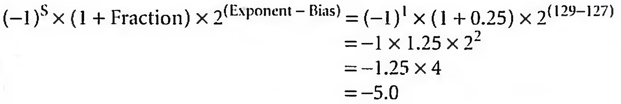
Converting Binary to Decimal Floating Point
31 | 30 …… 23 | 22 …… 0
1 | 1000 0001 | 010 0000 0000 0000 0000 0000
1 bit | 8 bits | 23 bits

Slide 17
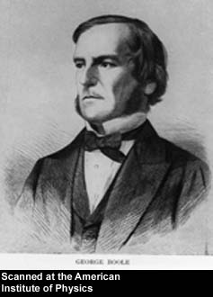
George Boole, 1815 - 1864
Born to working class parents
Taught himself mathematics and joined the faculty of Queen’s College in Ireland.
Wrote An Investigation of the Laws of Thought (1854)
Introduced binary variables
Introduced the three fundamental logic operations: AND, OR, and NOT.
Notes:
An Investigation of the Laws of Thought: 思维规律的研究

Slide 18
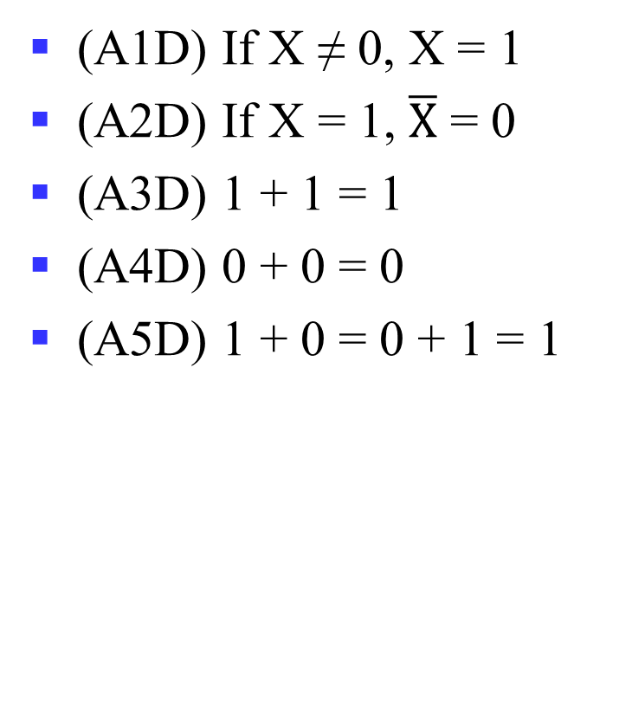
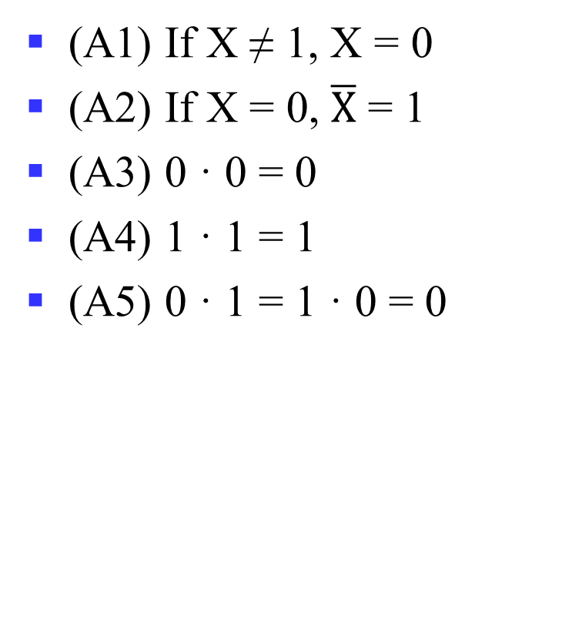
Axioms
(A1) If X ≠ 1, X = 0
(A2) If X = 0, $\overline{X}$ = 1
(A3) 0 · 0 = 0
(A4) 1 · 1 = 1
(A5) 0 · 1 = 1 · 0 = 0
(A1D) If X ≠ 0, X = 1
(A2D) If X = 1, $\overline{X}$ = 0
(A3D) 1 + 1 = 1
(A4D) 0 + 0 = 0
(A5D) 1 + 0 = 0 + 1 = 1

Slide 19
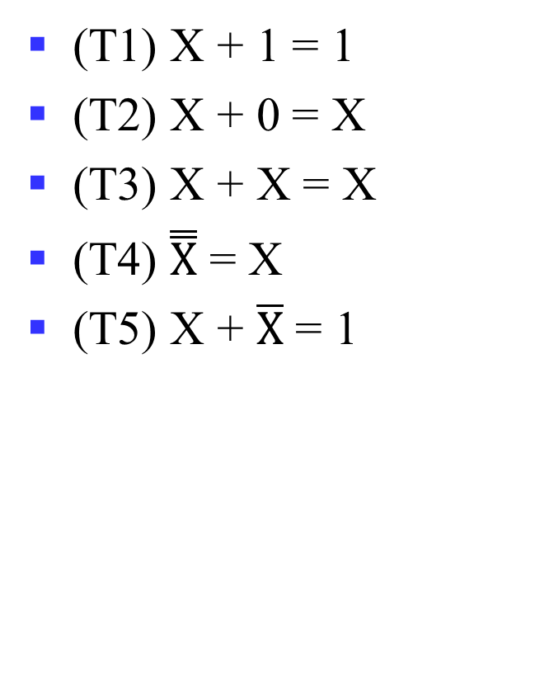
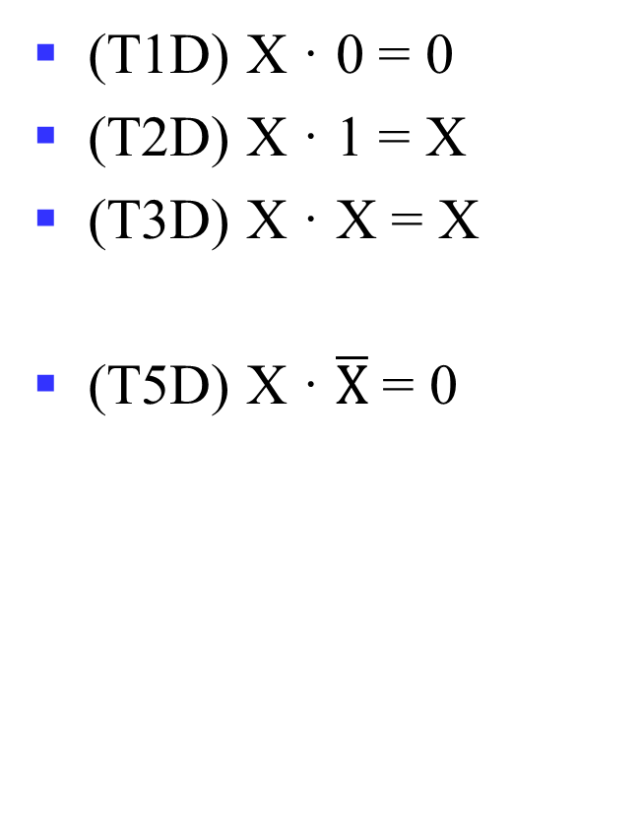
Theorems: Single Variable
(T1) X + 1 = 1
(T2) X + 0 = X
(T3) X + X = X
(T4) $\overset{̿}{X}$ = X
(T5) X + $\overline{X}$ = 1
(T1D) X · 0 = 0
(T2D) X · 1 = X
(T3D) X · X = X
(T5D) X · $\overline{X}$ = 0
Notes:
T1: Dominance 零律
T2: Identity 同一律
T3: Idempotent 幂等律
T4: Double negation 双重否定律
T5: Complement 互补律 （or T5: Excluded middle 排中律；T5D: Contradiction 矛盾律)

Slide 20
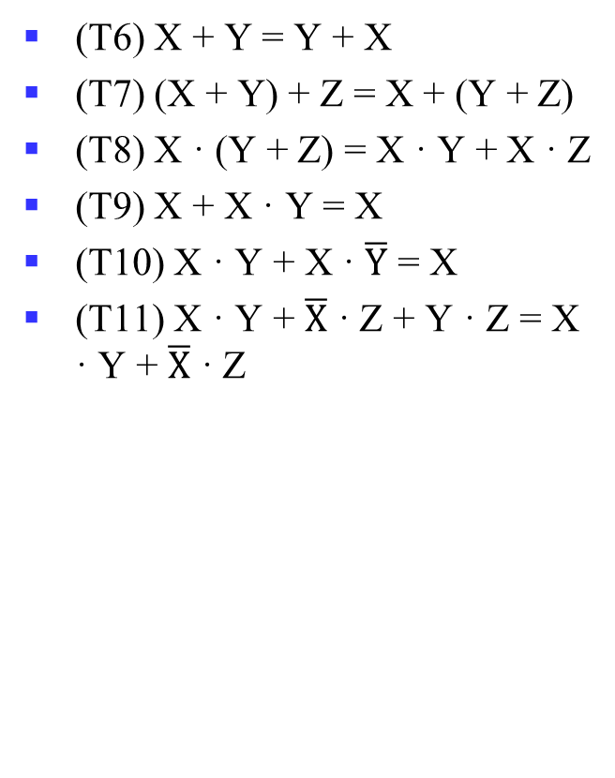
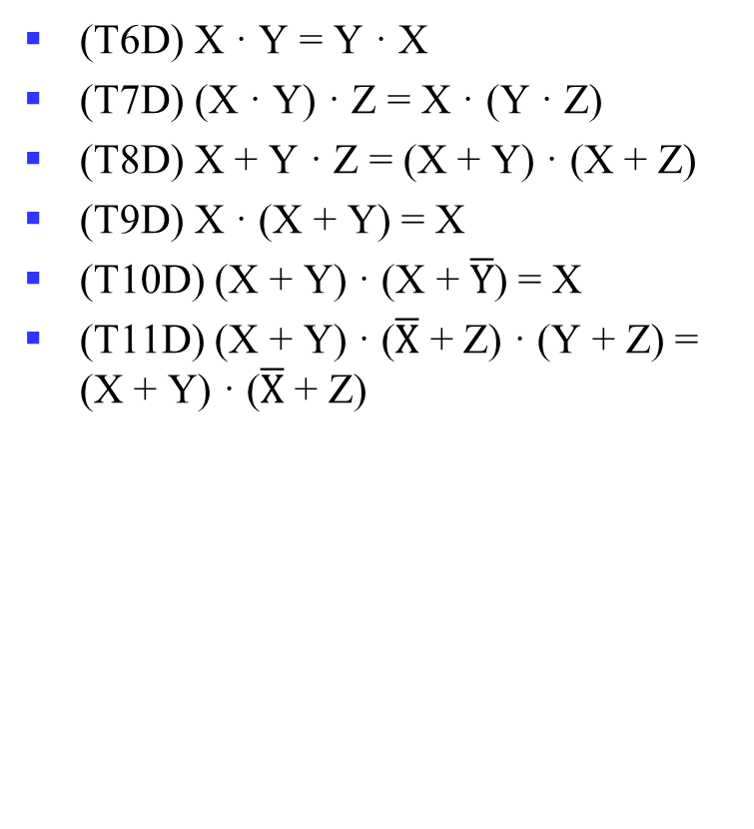
Theorems: 2-3 Variables
(T6) X + Y = Y + X
(T7) (X + Y) + Z = X + (Y + Z)
(T8) X · (Y + Z) = X · Y + X · Z
(T9) X + X · Y = X
(T10) X · Y + X · $\overline{Y}$ = X
(T11) X · Y + $\overline{X}$ · Z + Y · Z = X · Y + $\overline{X}$ · Z
(T6D) X · Y = Y · X
(T7D) (X · Y) · Z = X · (Y · Z)
(T8D) X + Y · Z = (X + Y) · (X + Z)
(T9D) X · (X + Y) = X
(T10D) (X + Y) · (X + $\overline{Y}$) = X
(T11D) (X + Y) · ($\overline{X}$ + Z) · (Y + Z) = (X + Y) · ($\overline{X}$ + Z)
Notes:
T6: 交换律 Commutative
T7: 结合律 Associative
T8: 分配律 Distributive
T9: 吸收律 Absorption
T10: 组合律 Adjacency
T11: 一致律 Consensus

Slide 21
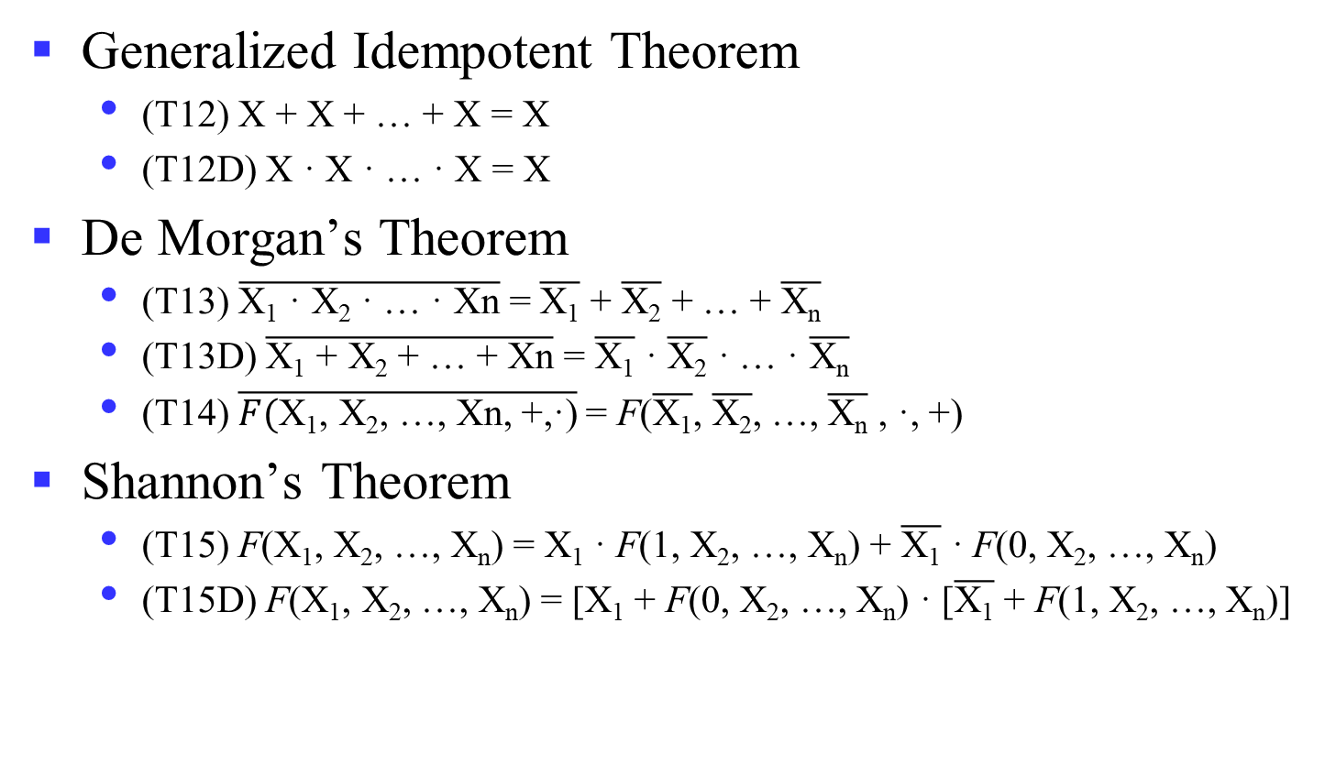
Theorems: n Variables
Generalized Idempotent Theorem
  (T12) X + X + … + X = X
  (T12D) X · X · … · X = X
De Morgan’s Theorem
  (T13) $\overline{\text{X}\text{1}\text{ · }\text{X}\text{2}\text{ · … · }\text{Xn}}$ = $\overline{\text{X}\text{1}}$ + $\overline{\text{X}\text{2}}$ + … + $\overline{\text{X}\text{n}}$
  (T13D) $\overline{\text{X}\text{1} \text{+} \text{X}\text{2} \text{+}\text{ … }\text{+} \text{Xn}}$ = $\overline{\text{X}\text{1}}$ $\text{·}$ $\overline{\text{X}\text{2}}$ $\text{·}$ … $\text{·}$ $\overline{\text{X}\text{n}}$
  (T14) $\overline{F(\text{X}\text{1}\text{,} \text{X}\text{2}\text{,}\text{ …}\text{,} \text{Xn}\text{, +,}\text{·}\text{)}}$= F($\overline{\text{X}\text{1}}\text{,}$ $\overline{\text{X}\text{2}}\text{,}$ …$\text{,}$ $\overline{\text{X}\text{n}}$ , $\text{·}$, +)
Shannon’s Theorem
  (T15) F(X₁, X₂, …, X_{n}) = X₁ · F(1, X₂, …, X_{n}) + $\overline{\text{X}\text{1}}$ · F(0, X₂, …, X_{n})
  (T15D) F(X₁, X₂, …, X_{n}) = [X₁ + F(0, X₂, …, X_{n}) · [$\overline{\text{X}\text{1}}$ + F(1, X₂, …, X_{n})]
Notes:
~(X+Y·Z) = ?
Wrong: (~X)·(~Y)+(~Z)?
XYZ=110
广义德摩根定理：对于一个逻辑表达式取反的结果，可以通过对每一项变量取反，并交换AND运算和OR运算而得到。
香农定理在组合逻辑函数的实现中有十分重要的应用，尤其是FPGA，利用LUT实现组合逻辑，但输入有限，通常为6变量函数。
如要实现7输入变量，则可利用香农定理，将两个6输入变量函数LUT的输出组合起来，可以实现任何7输入变量的逻辑函数。

Slide 22
Example 2: Boolean Algebraic Proofs
AB + AC + BC = AB + AC (Consensus Theorem)
Proof Steps
AB + AC + BC
= ?
Notes:
Justification 1: 1 . X = X
Justification 2: X + X’ = 1
= AB + A’C + ABC + A’BC X(Y + Z) = XY + XZ (Distributive Law)
= AB + ABC + A’C + A’BC X + Y = Y + X (Commutative Law)
= AB . 1 + ABC + A’C . 1 + A’C . B X . 1 = X, X . Y = Y . X (Commutative Law)
= AB (1 + C) + A’C (1 + B) X(Y + Z) = XY +XZ (Distributive Law)
= AB . 1 + A’C . 1 = AB + A’C X . 1 = X

Slide 23
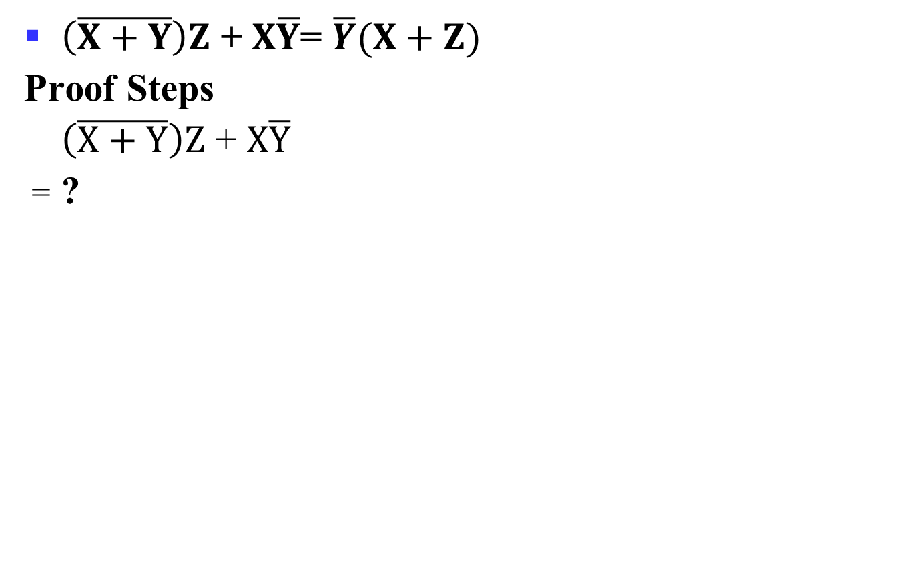
Example 3: Boolean Algebraic Proofs
$\left(\overline{X+Y}\right)Z$ + $X\overline{Y}$= $\overline{Y}(X+Z)$
Proof Steps
$\left(\overline{X+Y}\right)Z$ + $X\overline{Y}$
= ?
Notes:
= X’ Y’ Z + X Y’ (A + B)’ = A’ . B’ (DeMorgan’s Law)
= Y’ X’ Z + Y’ X A . B = B . A (Commutative Law)
= Y’ (X’ Z + X) A(B + C) = AB + AC (Distributive Law)
= Y’ (X’ + X)(Z + X) A + BC = (A + B)(A + C) (Distributive Law)
= Y’ . 1 . (Z + X) A + A’ = 1
= Y’ (X + Z) 1 . A = A, A + B = B + A (Commutative Law)

Slide 24
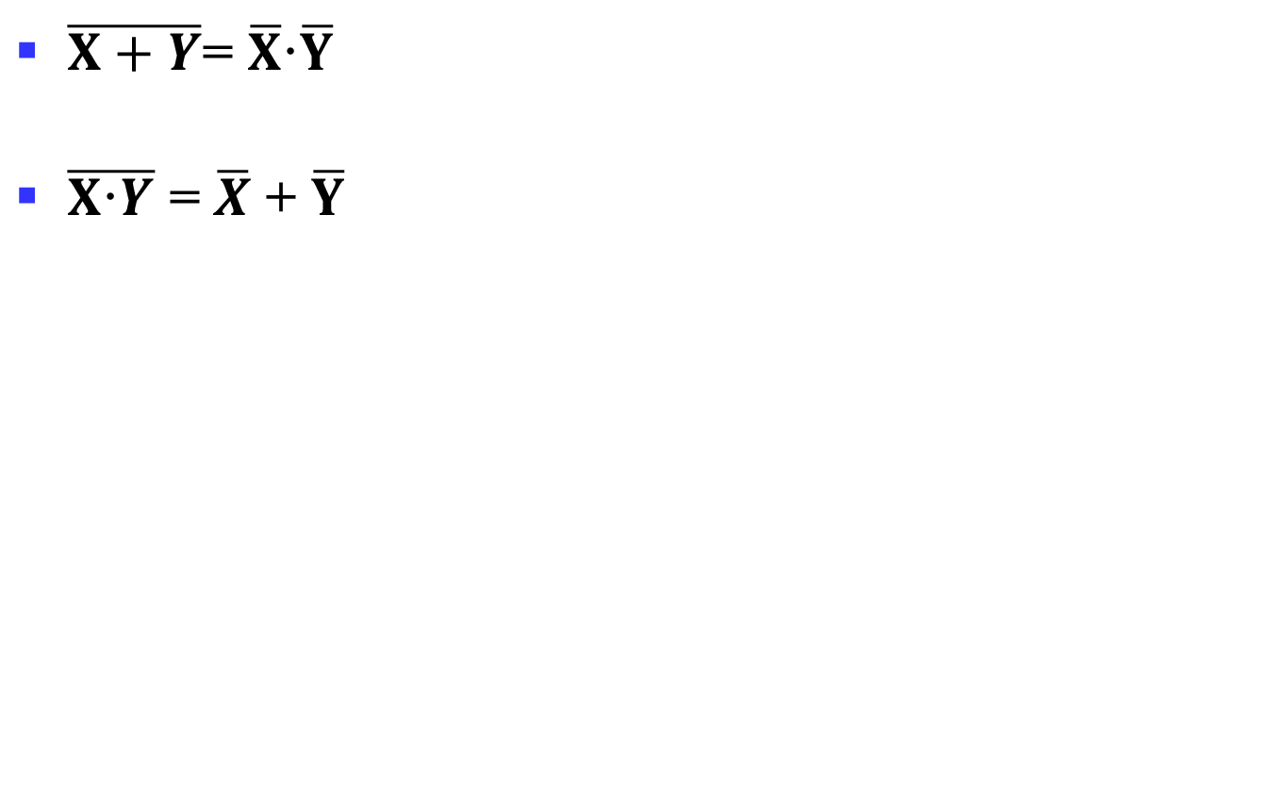
Proof of DeMorgan’s Laws
$\overline{X+Y}$= $\overline{X}\text{·}\overline{Y}$
$\overline{X\text{·}Y}$ = $\overline{X}$ + $\overline{Y}$
Notes:
It is important that we do not USE DeMorgan’s Laws in doing this proof.
This requires a different proof method. We will show that, x’ . y’, satisfies
the definition of the complement of (x + y), defined as (x + y)’ by
DeMorgan’s Law.
To show this we need to show that A + A’ = 1 and A.A’ = 0 with
A = x + y and A’ = x’. y’. This proves that x’. y’ = (x + y)’.
Part 1: Show x + y + x’. y’ = 1.
x + y + x’. y’
= (x + y + x’) (x + y + y’) X + YZ = (X + Y)(X + Z) (Distributive Law)
= (x + x’ + y) (x + y + y’) X + Y = Y + X (Commutative Law)
= (1 + y)(x + 1) X + X’ = 1
= 1 . 1 1 + X = 1
= 1 1 . X = 1
Part 2: Show (x + y) . x’. y’ = 0.
(x + y) . x’. y’
= (x . x’. y’ + y . x’. y’) X (Y + Z) = XY + XZ (Distributive Law)
= (x . x’. y’ + y . y’ . x’) XY = YX (Commutative Law)
= (0 . y’ + 0 . x’) X . X’ = 0
= (0 + 0) 0 . X = 0
= 0 X + 0 = X (With X = 0)
Based on the above two parts, x’y’ = (x + y)’
The second DeMorgans’ law is proved by duality. Note that DeMorgan’s
Law, given as an identity is not an axiom in the sense that it can be
proved using the other identities.

Slide 25
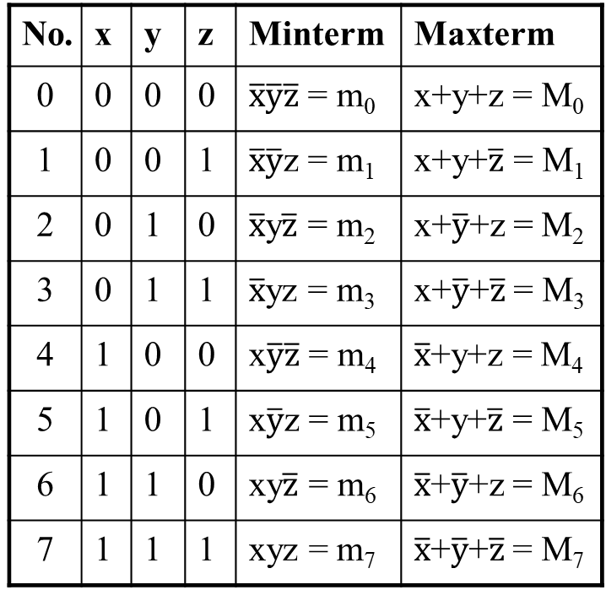
Truth Table notation for Minterms and Maxterms
Minterms and Maxterms are easy to denote using a truth table.
Example:
Assume 3 variables x,y,z
(order is fixed)
No. | x | y | z | Minterm | Maxterm
0 | 0 | 0 | 0 | $\overline{x}\overline{y}\overline{z}$ = m₀ | x+y+z = M₀
1 | 0 | 0 | 1 | $\overline{x}\overline{y}$z = m₁ | x+y+$\overline{z}$ = M₁
2 | 0 | 1 | 0 | $\overline{x}$y$\overline{z}$ = m₂ | x+$\overline{y}$+z = M₂
3 | 0 | 1 | 1 | $\overline{x}$yz = m₃ | x+$\overline{y}$+$\overline{z}$ = M₃
4 | 1 | 0 | 0 | x$\overline{y}\overline{z}$ = m₄ | $\overline{x}$+y+z = M₄
5 | 1 | 0 | 1 | x$\overline{y}$z = m₅ | $\overline{x}$+y+$\overline{z}$ = M₅
6 | 1 | 1 | 0 | xy$\overline{z}$ = m₆ | $\overline{x}$+$\overline{y}$+z = M₆
7 | 1 | 1 | 1 | xyz = m₇ | $\overline{x}$+$\overline{y}$+$\overline{z}$ = M₇

Slide 26
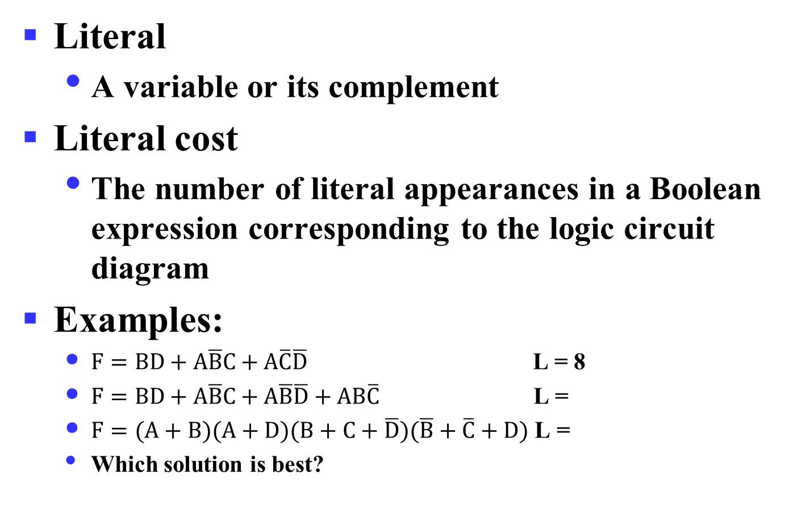
Literal Cost
Literal
  A variable or its complement
Literal cost
  The number of literal appearances in a Boolean expression corresponding to the logic circuit diagram
Examples:
  $F=BD+A\overline{B}C+A\overline{C}\overline{D}$ L = 8
  $F=BD+A\overline{B}C+A\overline{B}\overline{D}+AB\overline{C}$ L =
  $F=(A+B)(A+D)(B+C+\overline{D})(\overline{B}+\overline{C}+D)$ L =
  Which solution is best?
Notes:
2nd Literal Cost = 11
3rd Literal Cost = 10
The first solution is best

Slide 27
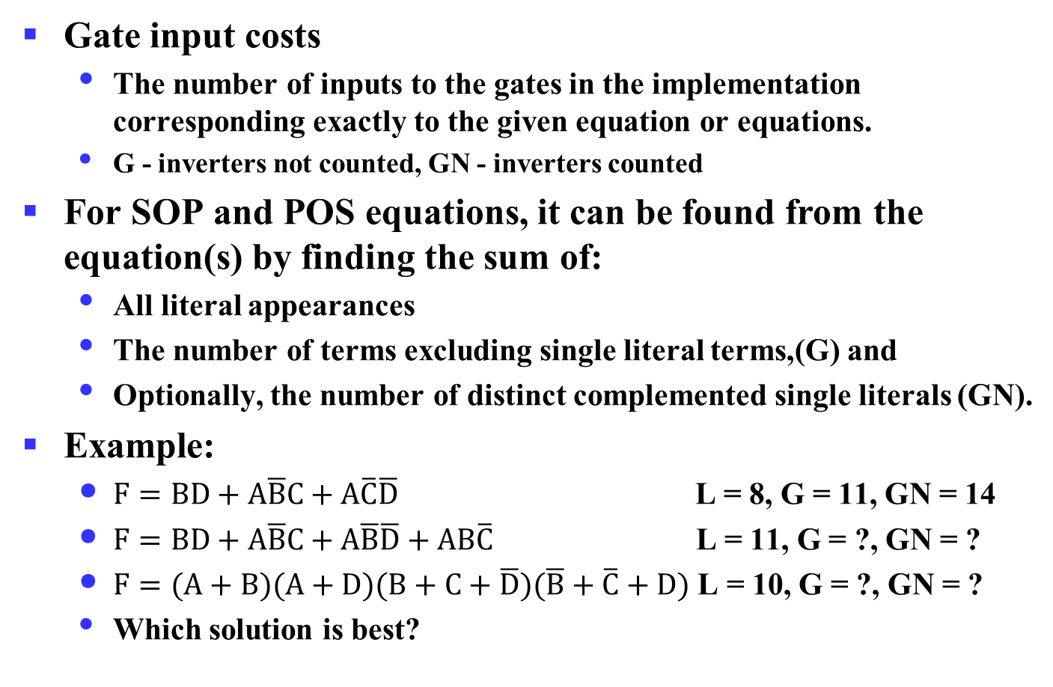
Gate Input Cost
Gate input costs
  The number of inputs to the gates in the implementation corresponding exactly to the given equation or equations.
  G - inverters not counted, GN - inverters counted
For SOP and POS equations, it can be found from the equation(s) by finding the sum of:
  All literal appearances
  The number of terms excluding single literal terms,(G) and
  Optionally, the number of distinct complemented single literals (GN).
Example:
  $F=BD+A\overline{B}C+A\overline{C}\overline{D}$ L = 8, G = 11, GN = 14
  $F=BD+A\overline{B}C+A\overline{B}\overline{D}+AB\overline{C}$ L = 11, G = ?, GN = ?
  $F=(A+B)(A+D)(B+C+\overline{D})(\overline{B}+\overline{C}+D)$ L = 10, G = ?, GN = ?
  Which solution is best?
Notes:
门输入成本，所用门的输入端的个数。
G = 15, GN = 18
G = 14, GN = 17
1st solution is best

Slide 28
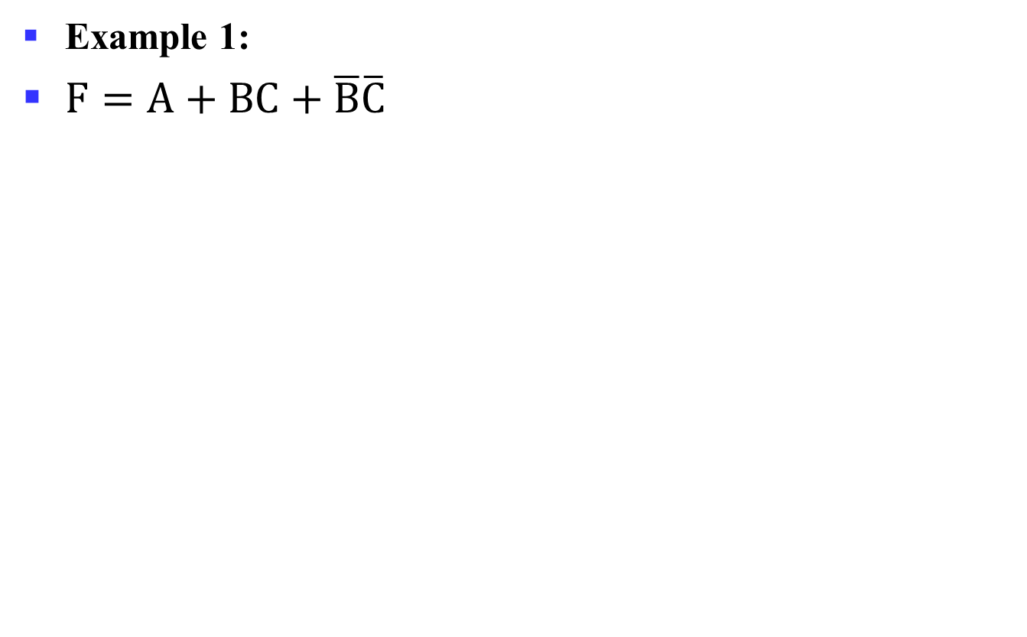
Cost Criteria (continued)
Example 1:
$F=A+BC+\overline{B}\overline{C}$
GN = G + 2 = 9
L = 5
G = L + 2 = 7
B
C
A
F
L (literal count) counts the AND inputs and the single literal OR input
G (gate input count) adds the remaining OR gate inputs
GN(gate input count with NOTs) adds the inverter inputs

Slide 29
N-Variable Karnaugh Map
Matrix with 2^{n} cells
  E.g., 2-variables, 3-variables and 4-variables
W
X
X
WX
 | 00 | 01 | 11 | 10
00 | m₀ | m₄ | m₁₂ | m₈
01 | m₁ | m₅ | m₁₃ | m₉
11 | m₃ | m₇ | m₁₅ | m₁₁
10 | m₂ | m₆ | m₁₄ | m₁₀
X
XY
YZ
 | 0 | 1
0 | m₀ | m₂
1 | m₁ | m₃
 | 00 | 01 | 11 | 10
0 | m₀ | m₂ | m₆ | m₄
1 | m₁ | m₃ | m₇ | m₅
Y
Z
Y
Z
Z
Y
Y
X
Notes:
不多于4变量的化简用卡诺图是较好的方法，函数在途中可被看成所有使函数取值为1的方格，其对应的最小项包含在函数中。
进一步地，卡诺图本质上是对一个函数所有可能地标准表示方式的图形化，通过相邻项合并求最优的表达。卡诺图可用于2级电路的优化，不能直接用于更多级的电路。

Slide 30
Simplification of Logic Functions
Example: F(X, Y, Z) = ∑ m(3, 5, 6, 7)
X
Index | X Y Z | F(X, Y, Z)
0 | 0 0 0 | 0
1 | 0 0 1 | 0
2 | 0 1 0 | 0
3 | 0 1 1 | 1
4 | 1 0 0 | 0
5 | 1 0 1 | 1
6 | 1 1 0 | 1
7 | 1 1 1 | 1
XY
 | 00 | 01 | 11 | 10
0 |  |  | 1
1 |  | 1 | 1 | 1
Z
Z
Y
XY
X · Y
 | 00 | 01 | 11 | 10
0 |  |  | 1
1 |  | 1 | 1 | 1
Z
X · Z
Y · Z

Slide 31
K-Map Definitions
Implicant
  Product of literals ABC, AC, BC
Prime implicant
  Implicant corresponding to the largest circle in a K-map, i.e., is a product term obtained by combining the maximum possible number of adjacent squares in the map into a rectangle with the number of squares a power of 2.
Essential prime implicant
  A prime implicant is called an Essential Prime Implicant if it is the only prime implicant that covers (includes) one or more minterms.
Notes:
Implicant：蕴涵项，如果一个乘积项包含了一个或多个最小项，那么称之为蕴涵项
Prime implicant：质蕴涵项，如果某个蕴涵项不能被该函数的其它蕴涵项所覆盖，则称为质蕴涵项
Essential prime implicant：实质蕴涵项，质蕴涵项覆盖的最小项中至少有一个最小项没有被其它质蕴涵项覆盖
如果逻辑函数的所有最小项都能被一组质蕴涵项覆盖，则该组质蕴涵项称为函数的一个覆盖，一定包含了所有的实质蕴涵项
F(A, B, C) = sigma m(1, 3, 4, 5, 7)

Slide 32
Example of Prime Implicants
Find ALL Prime Implicants
CD
ESSENTIAL Prime Implicants
C
C
B
D
B
D
1
1
1
1
1
1
BD
1
1
BD
1
1
B
B
1
1
1
1
A
A
A
B
1
1
1
1
1
1
1
1
D
D
AD
B
C
Minterms covered by single prime implicant

Slide 33
An Example with Don’t Cares

Slide 34
An Example with Don’t Cares

Slide 35
Single-Input Logic Gates

Slide 36
Two-Input Logic Gates

Slide 37
More Two-Input Logic Gates

Slide 38
What is Noise?
Anything that degrades the signal
  E.g., resistance, power supply noise, coupling to neighboring wires, etc.
Example: a gate (driver) outputs 5 V but, because of resistance in a long wire, receiver gets 4.5 V

Slide 39
Hi-Impedance Outputs (continued)
What is a Hi-Z value?
  1 —— high voltage
  0 —— low voltage
  Hi-Z value —— Open circuit，disconnected.
    It is as if a switch between the internal circuitry and the output has been opened.
Hi-Z may appear on the output of any gate, but we restrict gates to:
  a 3-state buffer
  a transmission gate
Feature: each of which has one data input and one control input.

Slide 40
The 3-State Buffer
The 3-State Buffer
  Symbol and truth table
  IN, data input,
  Out， Data Output
  EN, Control input，Enabled.
EN = 0
regardless of the value on IN (denoted by X), the output value is Hi-Z.
EN = 1 OUT = IN
Variations:
  Data input, IN, can be inverted
  Control input, EN, can be inverted
Symbol
IN
OUT
EN
Truth Table
EN
IN
OUT
0
X
Hi-Z
1
0
0
1
1
1

Slide 41
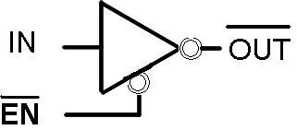
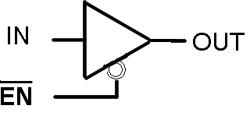
The 3-State Buffer
IN
OUT
EN

Slide 42
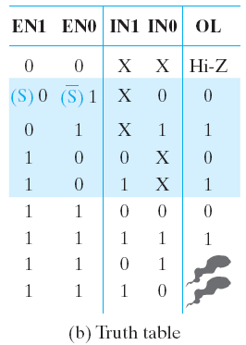
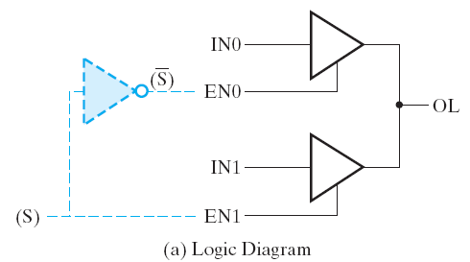
Multiplexed Line OL
Figure 2-34 Three-state Buffers Forming a Multiplexed Line OL

Slide 43
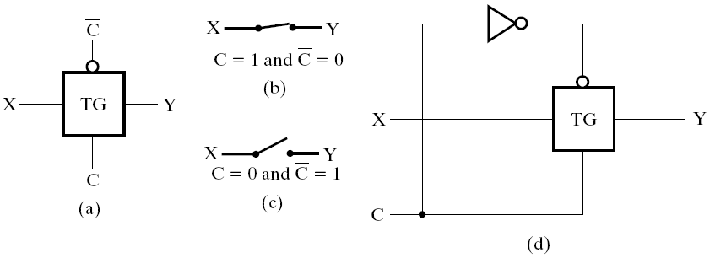
Transmission Gates
The transmission gate is one of the designs for an electronic switch for connecting and disconnecting two points in a circuit
Figure 2-35 Transmission Gates（TG）

Slide 44
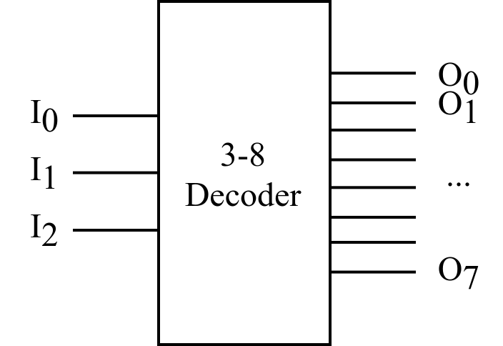
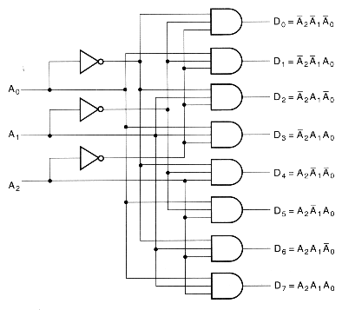
Decoder Examples (cont’d)
Input |  |  | Output
A₂ | A₁ | A₀ | D₀ | D₁ | D₂ | D₃ | D₄ | D₅ | D₆ | D₇
0 | 0 | 0 | 1 | 0 | 0 | 0 | 0 | 0 | 0 | 0
0 | 0 | 1 | 0 | 1 | 0 | 0 | 0 | 0 | 0 | 0
0 | 1 | 0 | 0 | 0 | 1 | 0 | 0 | 0 | 0 | 0
0 | 1 | 1 | 0 | 0 | 0 | 1 | 0 | 0 | 0 | 0
1 | 0 | 0 | 0 | 0 | 0 | 0 | 1 | 0 | 0 | 0
1 | 0 | 1 | 0 | 0 | 0 | 0 | 0 | 1 | 0 | 0
1 | 1 | 0 | 0 | 0 | 0 | 0 | 0 | 0 | 1 | 0
1 | 1 | 1 | 0 | 0 | 0 | 0 | 0 | 0 | 0 | 1
The 3-8-line is made up of 3 1-to-2-line decoders and 8 (3-inputs) AND gates.
Notes:
Gate input cost: 3 + 3 * 8 = 27

Slide 45
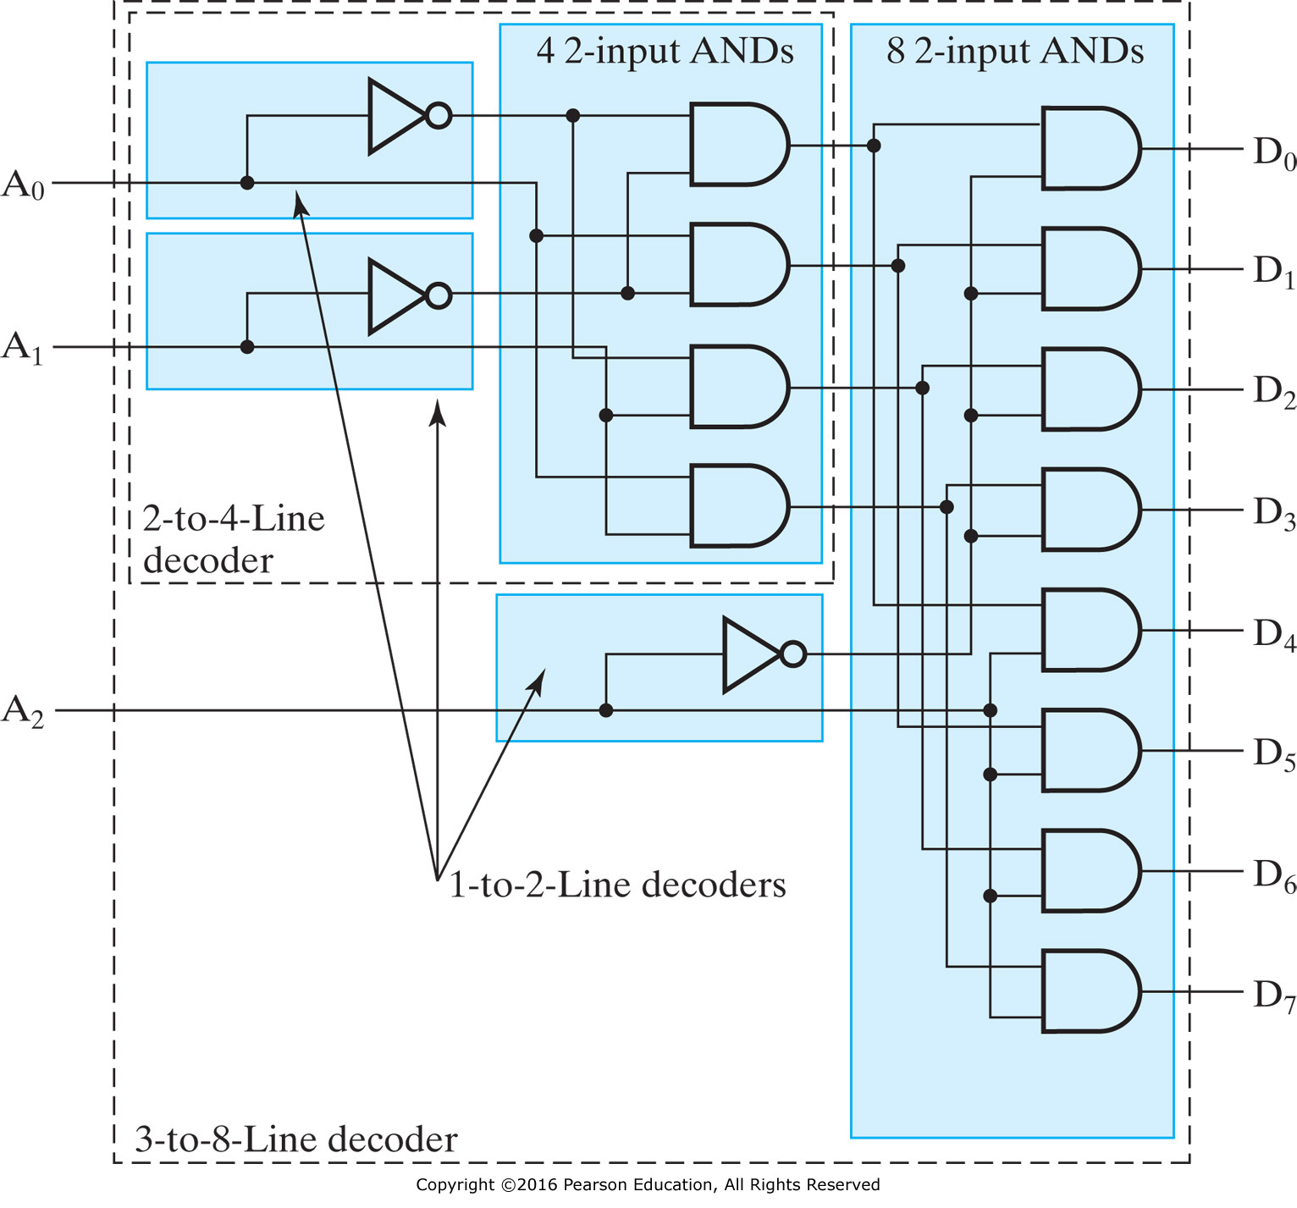
Decoder Expansion: 3-8 Decoder (cont’d)
Notes:
Gate input cost：3 + 2 * 4 + 2 * 8 = 27
How about 6-64 decoder?
6 + 6 * 64 = 390 vs. 6 + 2 * (2 * 4) + 2 * (2 * 8) + 2 * 64 = 182

Slide 46
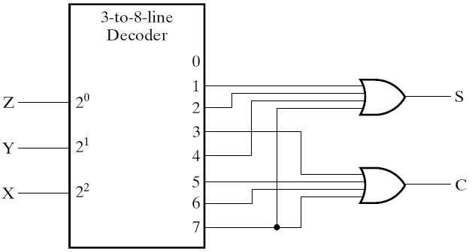
Decoder and OR Gates Example
Implement a binary Adder
Finding sum of
minterms expressions
S(X, Y, Z) = Σ_{m}(1, 2, 4, 7)
C(X, Y, Z) = Σ_{m}(3, 5, 6, 7)
Find circuit
Truth Table
Notes:
1位的二进制加法：X + Y，Z是来自低位的进位输入
输出S，进位输出位C

Slide 47
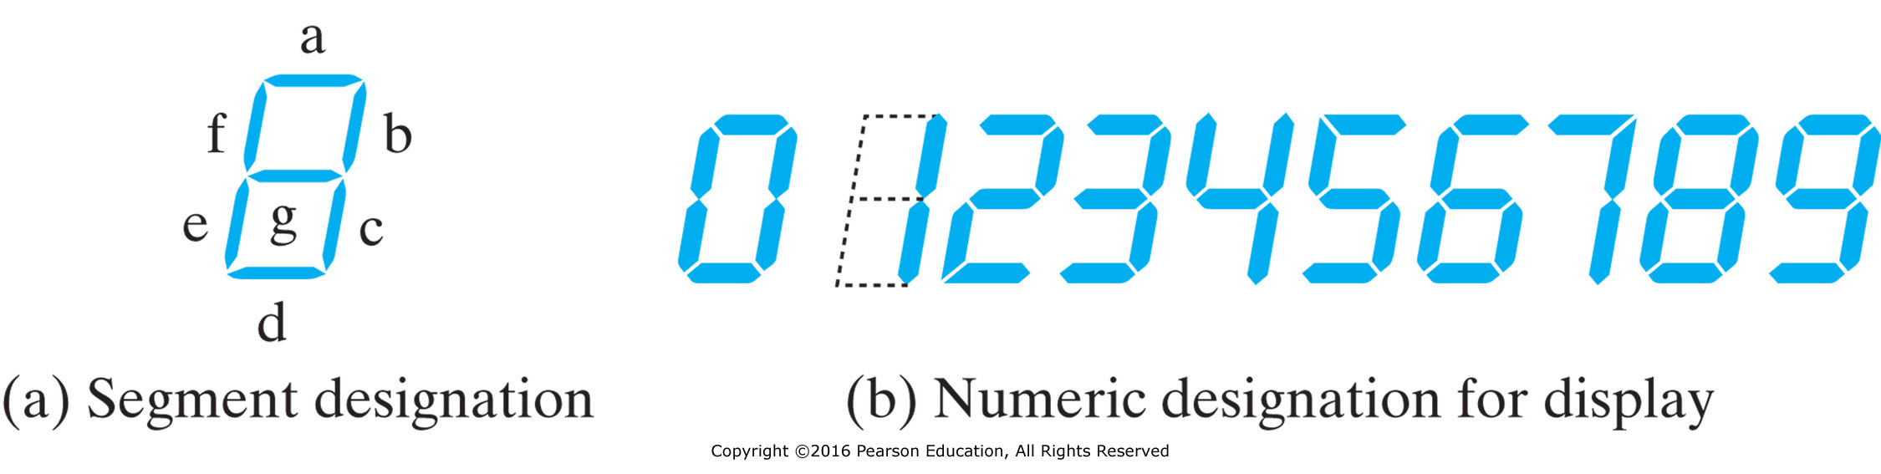
Seven-Segment Display Decoder
Input |  |  |  | Output
I₀ | I₁ | I₂ | I₃ | O_{a} | O_{b} | O_{c} | O_{d} | O_{e} | O_{f} | O_{g}
0 | 0 | 0 | 0 | 1 | 1 | 1 | 1 | 1 | 1 | 0
0 | 0 | 0 | 1 | 0 | 1 | 1 | 0 | 0 | 0 | 0
0 | 0 | 1 | 0 | 1 | 1 | 0 | 1 | 1 | 0 | 1
0 | 0 | 1 | 1 | 1 | 1 | 1 | 1 | 0 | 0 | 1
0 | 1 | 0 | 0 | 0 | 1 | 1 | 0 | 0 | 1 | 1
0 | 1 | 0 | 1 | 1 | 0 | 1 | 1 | 0 | 1 | 1
0 | 1 | 1 | 0 | 1 | 0 | 1 | 1 | 1 | 1 | 1
0 | 1 | 1 | 1 | 1 | 1 | 1 | 0 | 0 | 0 | 0
1 | 0 | 0 | 0 | 1 | 1 | 1 | 1 | 1 | 1 | 1
1 | 0 | 0 | 1 | 1 | 1 | 1 | 1 | 0 | 1 | 1
Seven-segment display decoder
Oa
I0
Ob
I1
Oc
Od
I2
Oe
I3
Of
Og
Notes:
4-16译码器+7个或门

Slide 48
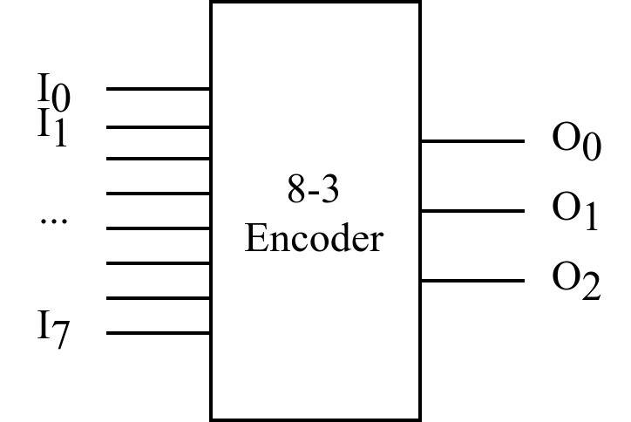
Classic Designs: Encoder
8-to-3-line encoder
Input |  |  |  |  |  |  |  | Output
I₀ | I₁ | I₂ | I₃ | I₄ | I₅ | I₆ | I₇ | O₀ | O₁ | O₂
1 | 0 | 0 | 0 | 0 | 0 | 0 | 0 | 0 | 0 | 0
0 | 1 | 0 | 0 | 0 | 0 | 0 | 0 | 0 | 0 | 1
0 | 0 | 1 | 0 | 0 | 0 | 0 | 0 | 0 | 1 | 0
0 | 0 | 0 | 1 | 0 | 0 | 0 | 0 | 0 | 1 | 1
0 | 0 | 0 | 0 | 1 | 0 | 0 | 0 | 1 | 0 | 0
0 | 0 | 0 | 0 | 0 | 1 | 0 | 0 | 1 | 0 | 1
0 | 0 | 0 | 0 | 0 | 0 | 1 | 0 | 1 | 1 | 0
0 | 0 | 0 | 0 | 0 | 0 | 0 | 1 | 1 | 1 | 1
$$O0=I4+I5+I6+I7$$
$$O1=I2+I3+I6+I7$$
$$O2=I1+I3+I5+I7$$
OR gates!
However, there exists two issues that may make the encoder just designed does not work:
  1. If more than one input value is 1 (e.g., I3 & I6 are both 1)
  2. All inputs are 0 vs. I0 = 1

Slide 49
4-to-1-line Multiplexer (cont’d)
2-to-2²-line decoder
2² × 2 AND-OR
S
Decoder
1
S
4
×
2 AND-OR
0
Decoder
S
Decoder
S
1
1
S
S
0
I
0
0
Y
I
1
Y
Y
I
2
I
3
Notes:
F = (S₁’S₀’)A + (S₁’S₀)B + (S₁S₀’)C + (S₁S₀)D
Cost: 4 + 2 * 8 + 2 = 22

Slide 50
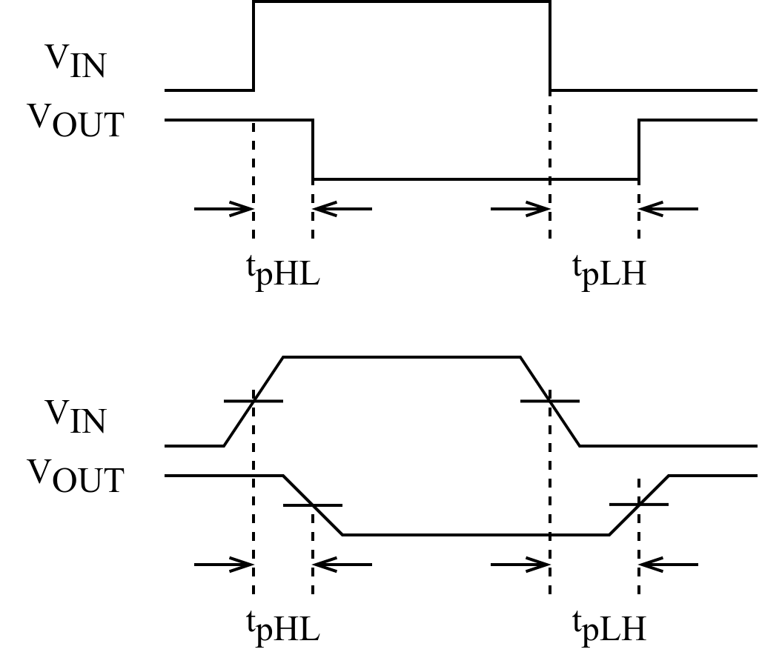
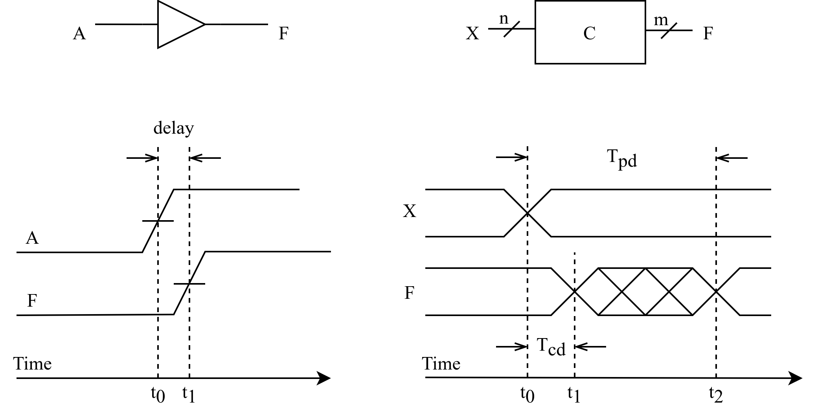
Timing Analysis
Circuit delay
Ideal case
In practice
Delay of the invertor
Rise-time delay of the transmission gate
Notes:
信号通过连线以及电路元件时，会有一定的延迟：连线的长短、元件的数量、电路制造工艺、工作电压、温度等；此外信号的高低电平转换也需要一定的过渡时间。
任何组合逻辑电路从输入信号的改变到随之引起的输出信号的改变中间都有一定的时间延迟。
理想情况：忽略上升时间和下降时间
为避免信号上升过程和下降过程时间不一致带来的影响，通常取信号转换的中点来测量电路的延迟时间。
缓冲器电路的时序图（上升沿电路延迟）：时间位t0和t1之间的间隔，分别是输入A和输出F两个信号的上升沿的中间点。

Slide 51
Timing Analysis (cont’d)
Propagation delay
  T_{pd} = max delay from input to output
Contamination delay
  T_{cd} = min delay from input to output
Reasons why T_{pd} and T_{cd} may be different:
  Different rising and falling delays
  Multiple inputs and outputs, some of which are faster than others
  Circuits slow down when hot and speed up when cold
Notes:
组合逻辑电路的时序特征包括：
1. Propagation delay: 传输延迟，从输入端的变化开始到所有输出端得到最终稳定的信号所需的最长时间
2. Contamination delay：最小延迟，从输入端变化开始到任何一个输出开始发生改变所需的最短时间
电路延迟可以通过计算信号从输入到输出所经过的路径上每个元件的延迟之和得到。

Slide 52
Timing Analysis (cont’d)
The critical (longest) path
  T_{pd} of the circuit = ∑ all T_{pd} of circuit elements along the critical path
The shortest path
  T_{cd} of the circuit = ∑ all T_{cd} of circuit elements along the shortest path
Tpd = 2Tpd_AND + Tpd_OR
Tcd = Tcd_AND
Notes:
1) 一个组合电路在输入和输出之间经过的最长路径称为关键路径，因此组合电路的传输延迟就是关键路径上所有元件的传输延迟之和；
2) 最小延迟就是最短路径上所有元件的最小延迟之和。

Slide 53
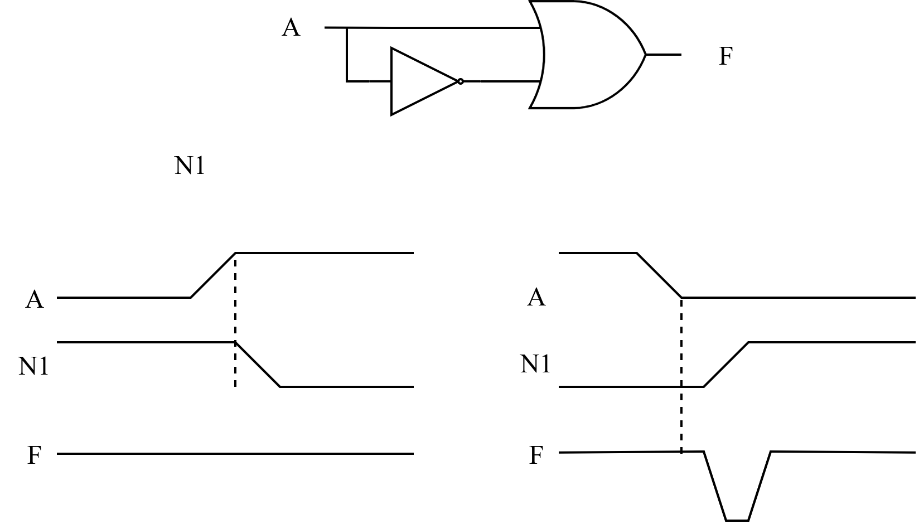
Timing Analysis (cont’d)
Race hazard
  Glitch: when a single input change causes multiple output changes
N1
Race hazard in a circuit
No glitch
Glitch
Notes:
如果存在某个输入信号经过两条或者两条以上的路径作用到输出端F，由于路径延迟不同，输入信号会对输出信号发生先后不同的影响，即竞争（race）。
由于竞争的存在，当多路输入信号的电平值发生变化时，在信号变化的瞬间，电路的输出信号可能会出现一些不正确的尖峰信号，即毛刺（glitch）。
如果要给组合逻辑电路中有毛刺出现，说明改电路存在冒险（hazard），或竞争冒险。
A从低电平变为高电平，N1随之从高变低，N1变为低电平之前，A已经变为高电平，所以F一直是高电平，无毛刺；反之则有毛刺。
如果输出信号最终将稳定在正确的电平上，毛刺通常不会导致问题，只要在获取电路输出值之前至少等待传输延迟的时间即可。

Slide 54
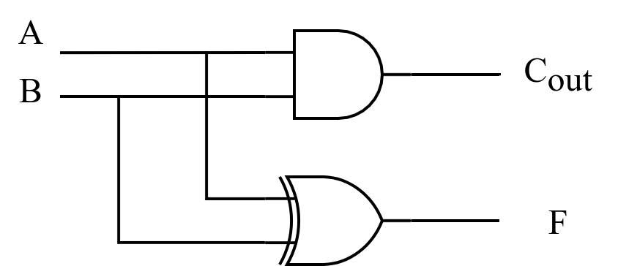
1-bit adder: Half-Adder
A 2-input, 1-bit width binary adder that performs the following computations:
A half adder adds two bits to produce a two-bit sum
The sum is expressed as a sum bit , F and a carry bit, C
The half adder can be specified as a truth table for F and C ⇒
A
0
0
1
1
+ B
+ 0
+ 1
+ 0
+ 1
C F
0 0
0 1
0 1
1 0
A
B
F
C
0
0
0
0
0
1
1
0
1
0
1
0
1
1
0
1
Notes:
F= A XOR B
Cout = AB

Slide 55
1-bit adder: Full Adder
A full adder is similar to a half adder, but includes a carry-in bit from lower stages.
Like the half-adder, it computes a sum bit F and a carry bit C_{in}
  For a carry-in (C_{in}) of 0, it is the same as the half-adder:
  For a carry-in
  (C_{in}) of 1:
Cin
0
0
0
0
A
0
0
1
1
+ B
+ 0
+ 1
+ 0
+ 1
Cout F
0
0
0 1
0 1
1 0
Cin
1
1
1
1
A
0
0
1
1
+ B
+ 0
+ 1
+ 0
+ 1
Cout F
0 1
1 0
1 0
1
1
Notes:
F = A XOR B XOR C_{in}
C_{out} = AB + AC_{in} + Bc_{in}

Slide 56
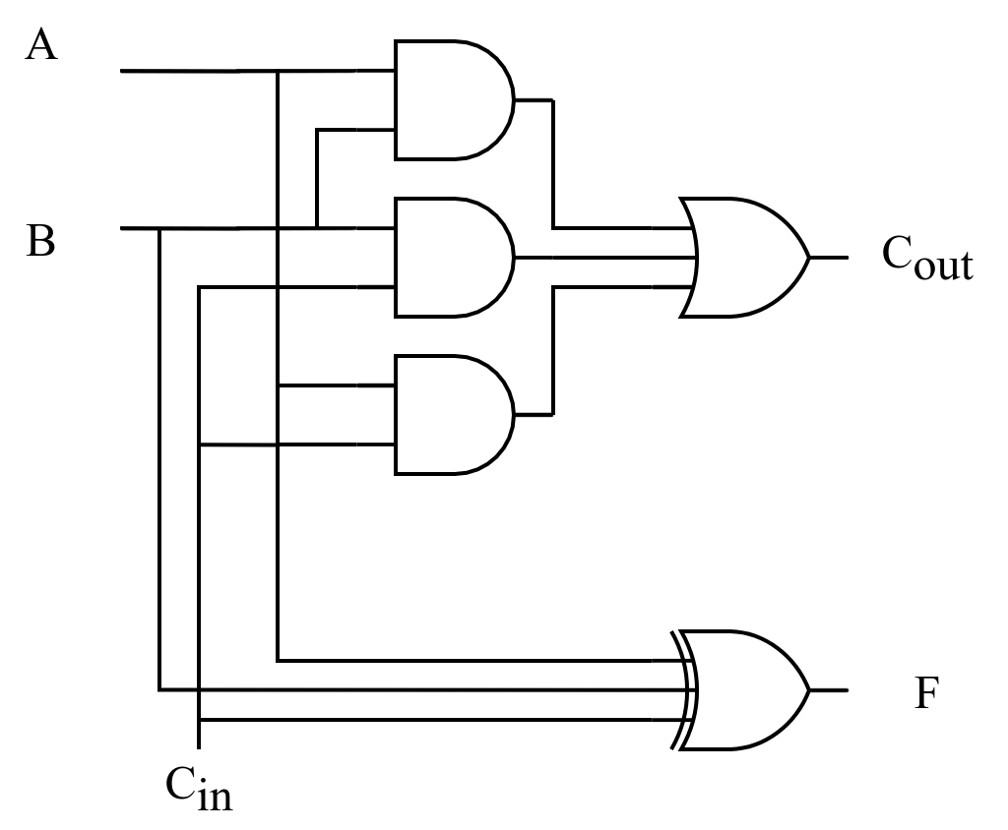
Classic Designs: Full Adder (cont’d)
Input |  |  | Output
A | B | C_{in} | F | C_{out}
0 | 0 | 0 | 0 | 0
0 | 0 | 1 | 1 | 0
0 | 1 | 0 | 1 | 0
0 | 1 | 1 | 0 | 1
1 | 0 | 0 | 1 | 0
1 | 0 | 1 | 0 | 1
1 | 1 | 0 | 0 | 1
1 | 1 | 1 | 1 | 1
Notes:
F = A XOR B XOR C_{in} = (A XOR B) XOR C
C_{out} = AB + AC_{in} + Bc_{in} = AB + C_{in}(A + B)
2 HA + OR -> FA

Slide 57
Ripple-Carry Adder (RCA)
Chain 1-bit adders together
Carry ripples through entire chain
Disadvantage: slow

Slide 58
Carry Lookahead Adder
P
=
A
⊕
B
G
=
A
B
i
i
i
i
i
i
S
=
P
⊕
C
C
=
G
+
P
C
i
i
i
i
+
1
i
i
i
Ai
Bi
For a given i-bit binary adder,
  If A_{i} = B_{i} = “1” and whatever C_{i} is, we have carry out as 1, that is C_{i+1} = 1
  If the output of half adder is 1 and we have carry in as 1, we have carry out as 1，that is C_{i+1} = 1
These two conditions of setting carry out as 1 is called generate (G_{i}) and propagate (P_{i}).
Gi
Pi
Ci
Ci+1
Si
Notes:
C1=G0+P0C0
C2=G1+P1C1=G1+P1G0+P1P0C0

Slide 59
Carry Lookahead Development
C_{i+1} = G_{i} + P_{i}C_{i} can be removed from the cells and used to derive a set of carry equations spanning multiple cells.
Beginning at the cell 0 with carry in C₀:
C1 = G0 + P0 C0
C2 = G1 + P1 C1 = G1 + P1(G0 + P0 C0)
= G1 + P1G0 + P1P0 C0
C3 = G2 + P2 C2 = G2 + P2(G1 + P1G0 + P1P0 C0)
= G2 + P2G1 + P2P1G0 + P2P1P0 C0
C4 = G3 + P3 C3
= G3 + P3G2 + P3P2G1+ P3P2P1G0 + P3P2P1P0 C0
Notes:
公式看着复杂，但是只有两级门，延迟大大减小。坏处是成本大，

Slide 60
4-Bit CLA
Partial full adder
Carry Look-ahead Adder

Slide 61
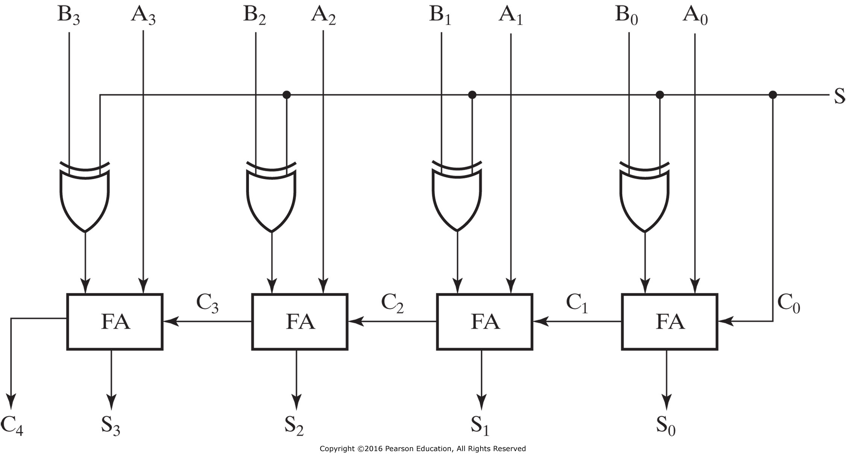
4-Bit Binary Adder-Subtractors
When S=0: Addition (A+B)
When S=1: Subtraction (A+2’s complement of B)
Can be used to add/subtract unsigned numbers and signed 2’s complement numbers

Slide 62
Carry & Overflow
Carry is important when…
  Adding or subtracting unsigned integers
  Indicates that the unsigned sum is out of range
  Either < 0 or > maximum unsigned n-bit value
Overflow is important when…
  Adding or subtracting signed integers
  Indicates that the signed sum is out of range
Overflow occurs when?
Notes:
广义来讲，carry可被视为unsigned number的overflow
In unsigned magnitude addition
A carry out of the left-most bit is also an overflow
In unsigned magnitude subtraction
Overflow will occur in subtraction if we must borrow prior to the left-most bit

Slide 63
Signed Overflow
With two’s complement and a 4-bit adder, for example, the largest representable decimal number is +7, and the smallest is -8.
What if you try to compute 4 + 5, or (-4) + (-5)?
We cannot just include the carry out to produce a five-digit result, as for unsigned addition. If we did, (-4) + (-5) would result in +23!
Also, unlike the case with unsigned numbers, the carry out cannot be used to detect overflow, by itself
  In the example on the left, the carry out is 0 but there is overflow.
  Conversely, there are situations where the carry out is 1 but there is no overflow.
0 1 0 0 (+4)
+ 0 1 0 1 (+5)
0 1 0 0 1 (-7)
1 1 0 0 (-4)
+ 1 0 1 1 (-5)
1 0 1 1 1 (+7)

Slide 64
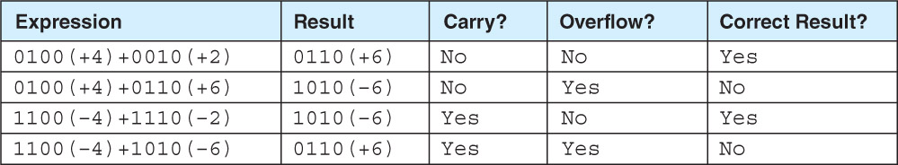
How to Detect Signed Overflow?
The impact of carry and overflow
The easiest way to detect signed overflow is to look at all the sign bits.
Examples of four signed additions
0 1 0 0 (+4)
+ 0 1 0 1 (+5)
0 1 0 0 1 (-7)
1 1 0 0 (-4)
+ 1 0 1 1 (-5)
1 0 1 1 1 (+7)
Notes:
1111 + 0001 = 0000 should set carry (15 + 1 = 0 is false) and clear overflow (-1 + 1 = 0 is true).
0111 + 0010 = 1001 should clear carry (7 + 2 = 9 is true) and set overflow (7 + 2 = -7 is false).
1001 + 1001 = 0010 should set both (9 + 9 = 2 and -7 + -7 = 2 are both false).

Slide 65
Detecting Signed Overflow
Overflow occurs only in the two situations:
  Adding two positive numbers and the sum is negative
  Adding two negative numbers and the sum is positive
  Can happen because of the fixed number of sum bits
Overflow cannot occur if you add a positive number to a negative number. Do you see why?
In two’s complement addition/subtraction
  If the two numbers have the same sign bit and the sum/difference has a different sign bit, then overflow
  Or, if the carry out flags of the sign bit and the highest value bit are different

Slide 66
Overflow Detection
For unsigned number
  Add
    The carry of 1 indicates overflow
  Subtraction
    The carry of 1 indicates that no correction of the result is required
    The carry of 0 indicates that a correction of the result is required
For signed number
  V = C_{n} ⊕ C_{n-1}

Slide 67
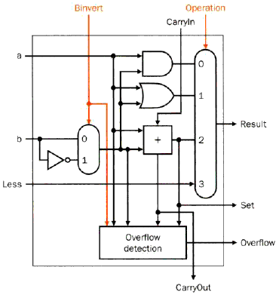
Set Less Than (SLT) Example
Configure 32-bit ALU for SLT operation: A = 25 and B = 32
  A < B, so Y should be 32-bit representation of 1 (0x00000001)
  slt rd,rs,rt
  If rs < rt, rd=1, else rd=0
  For rd, all bits = 0 except the least significant
  Subtraction (rs - rt), if the result is negative→ rs < rt
  Use of sign bit as indicator
Least
significant bit
Most
significant bit
Notes:
最高位0扩展

Slide 68
Various Use of Shifters
Logical shifter: shifts value to left or right and fills empty spaces with 0’s
  11001 >> 2 = 00110
  11001 << 2 = 00100
Arithmetic shifter: same as logical shifter, but on right shift, fills empty spaces with the old most significant bit (MSB).
  11001 >>> 2 = 11110
  11001 <<< 2 = 00100
Rotator: rotates bits in a circle, such that bits shifted off one end are shifted into the other end
  11001 ROR 2 = 01110
  11001 ROL 2 = 00111

Slide 69
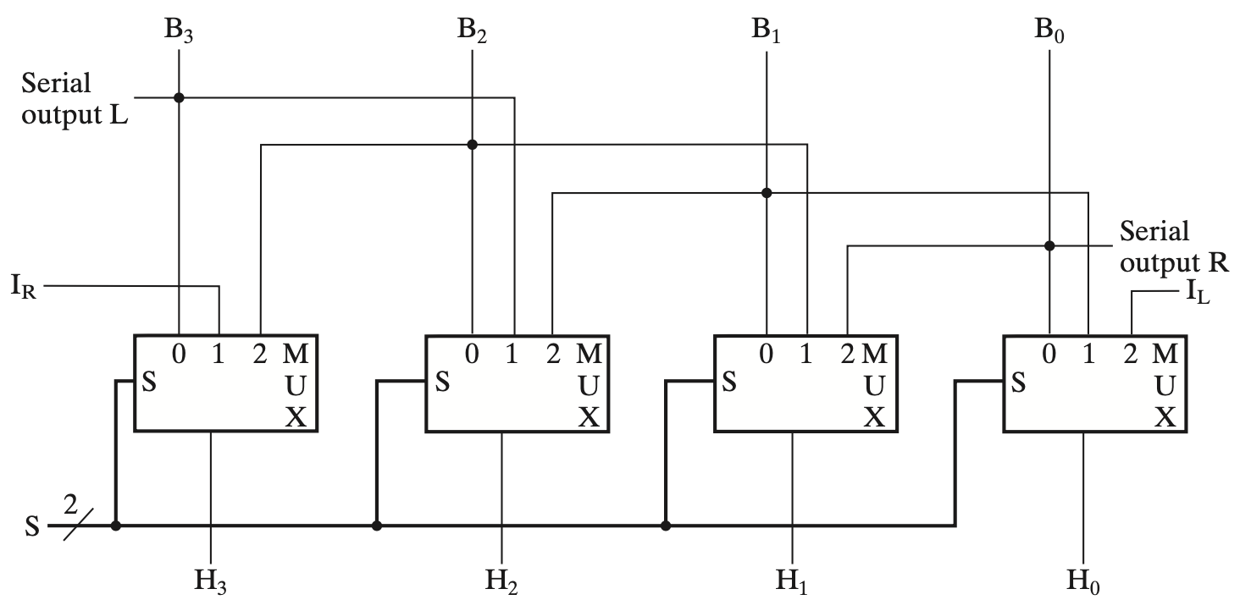
Shifter Design as A Combinational Circuit
Notes:
4-Bit Basic Shifter
0：load
1: 右移
2：左移

Slide 70
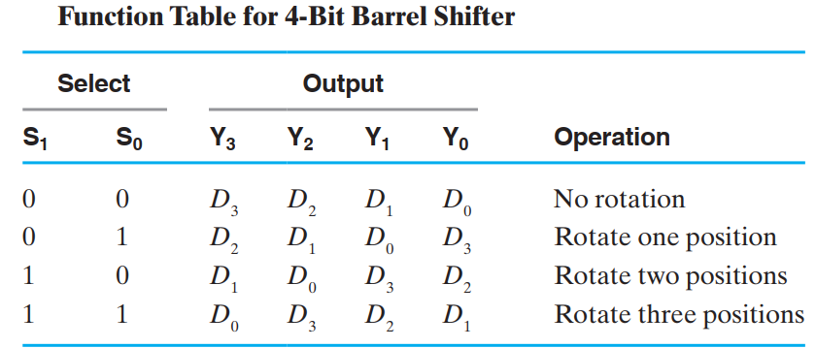
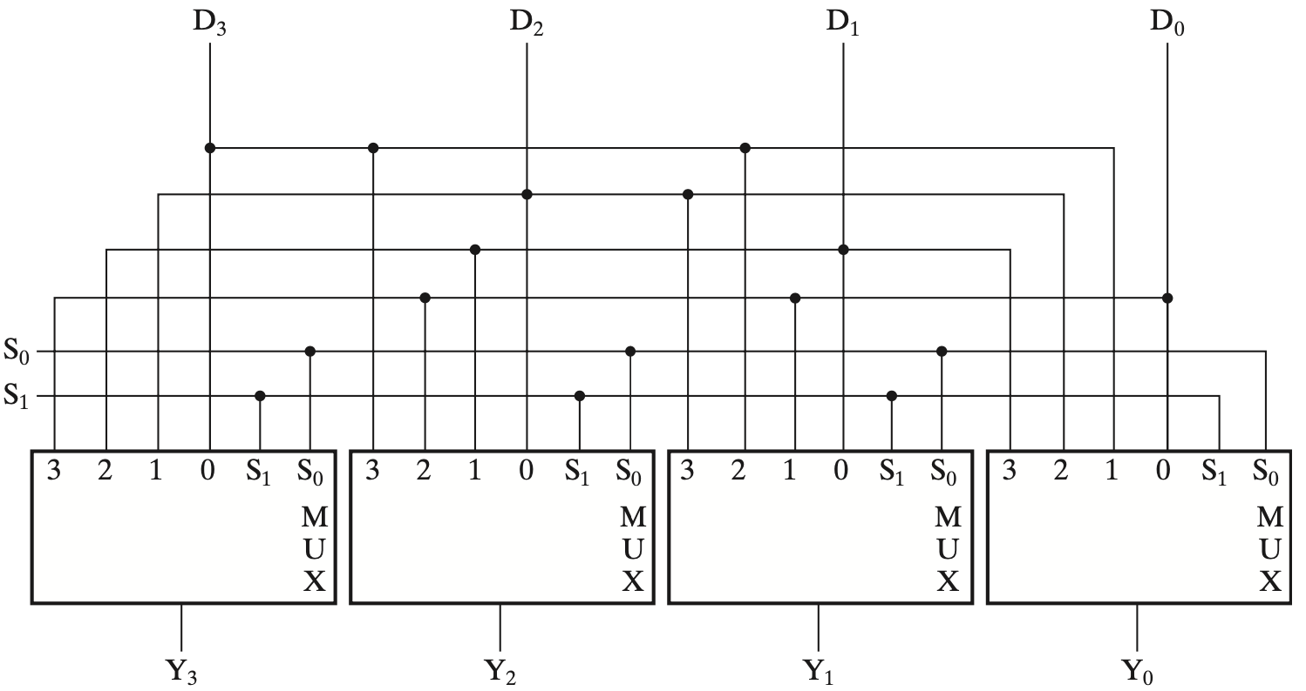
4-Bit Barrel Shifter (ROL)

Slide 71
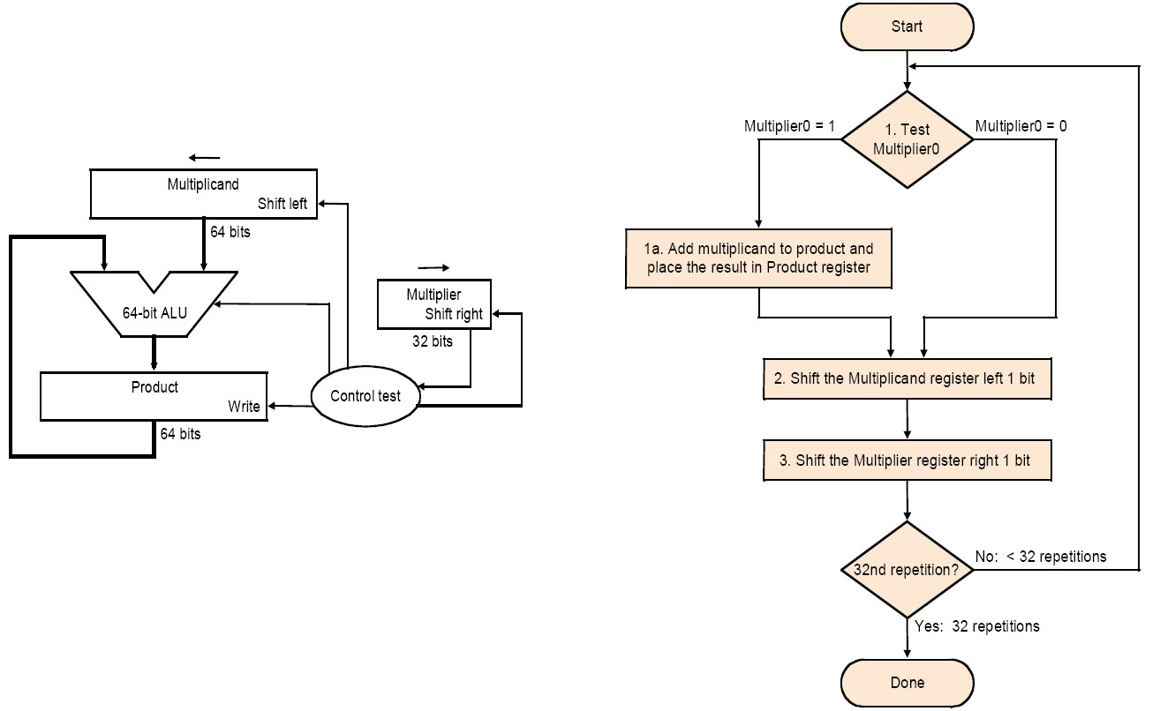
Implementation 1
Notes:
需要多个时钟周期完成，属于时序逻辑电路，由时钟信号控制。

Slide 72
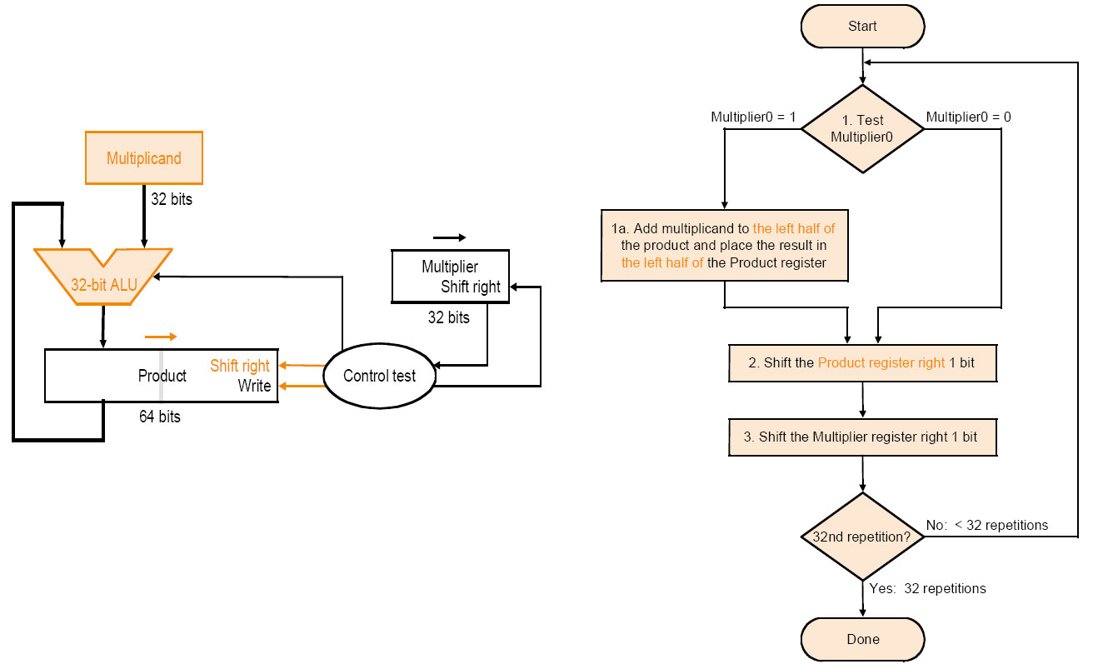
Implementation 2
Multiplicand stationary - Multiplier right - PP right
Notes:
计算机中为了提高效率，做了如下改进：
每次将乘数的一位乘以被乘数后（X x Y_{i}），将结果与前面所得累加，称为为部分积；
对乘数中为1的位执行加法和右移运算，对为0的位只执行右移运算，不需执行加法运算；
每次求得X x Y_{i}后，不是将它左移与前次部分积相加，而是将部分积右移一位与X x Y_{i}相加。

Slide 73
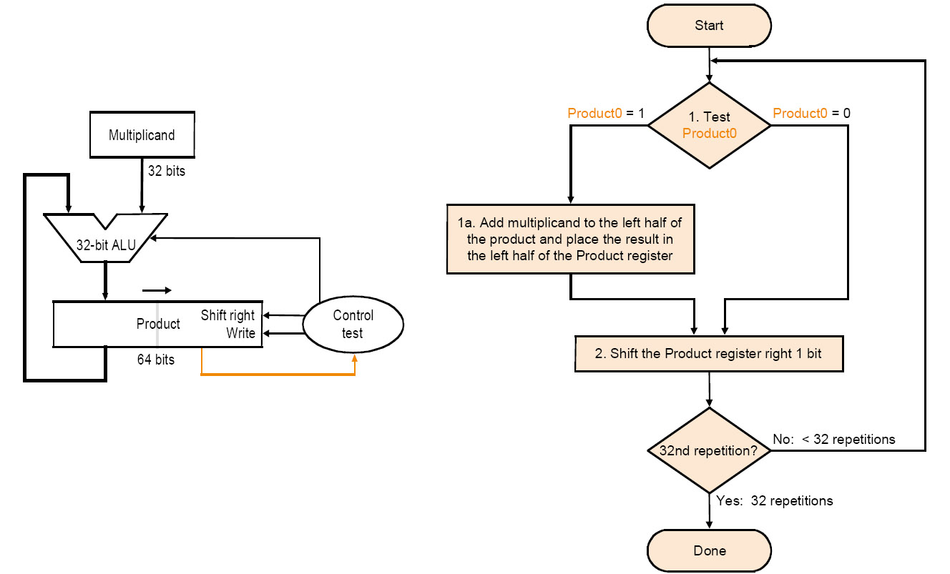
Implementation 3
Multiplier on right half of PP reg
Multiplicand stationary - Multiplier right - PP right

Slide 74
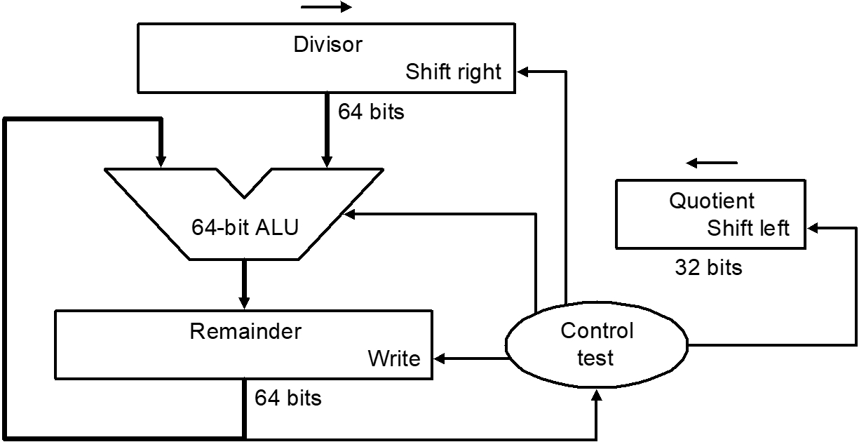
Implementation 1
 |  |  |  |  |  |  |  | 1 | 0 | 0 | 1 | Quotient
Divisor | 1 | 0 | 0 | 0 | 1 | 0 | 0 | 1 | 0 | 1 | 0 | Dividend
 |  |  |  | - | 1 | 0 | 0 | 0
 |  |  |  |  |  |  |  | 1 | 0
 |  |  |  |  |  |  |  | 1 | 0 | 1
 |  |  |  |  |  |  |  | 1 | 0 | 1 | 0
 |  |  |  |  |  |  | - | 1 | 0 | 0 | 0
 |  |  |  |  |  |  |  |  |  | 1 | 0 | Remainder
2. Do the division
1. Place dividend in lower half
3. Get remainder here

Slide 75
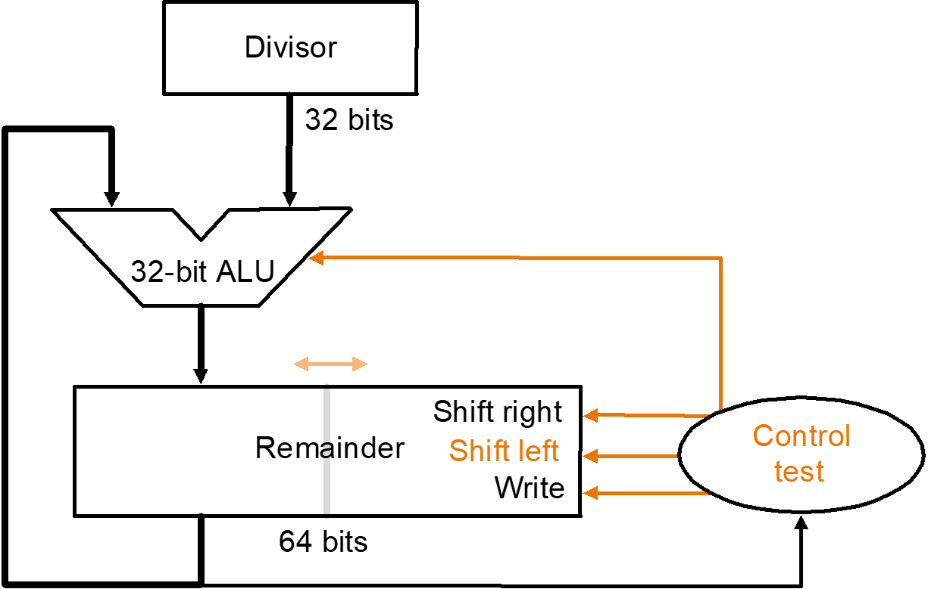
Implementation 2
2. Do the division
1. Place dividend in lower half
3. Get remainder here
4. Get quotient here

Slide 76
Gate Delay Models
A
Consider a simple of 2-input multiplexer with function:
  Y = A for S = 0
  Y = B for S = 1
0.4
0.2
Y
0.5
S
B
0.4
A
B
S
S
Y
“Glitch” is due to delay of inverter

Slide 77
Circuit Delay Model
What if Y connected to A?
Circuit becomes:
With function:
  Y = B for S = 1, and
  Y(t) dependent on
  Y(t – 0.9) for S = 0
The simple combinational circuit now becomes a sequential circuit because its output is a function of a time sequence of input signals!
0.4
0.2
0.5
S
Y
B
0.4
B
S
S
Y
Y is stored value in shaded area

Slide 78
Basic (NAND) S – R Latch
“Cross-Coupling” two NAND gates gives the S -R Latch:
Which has the time sequence behavior:
S = 0, R = 0 is
forbidden as
input pattern
S (set)
Q
Q
R (reset)
Time
R
S
Q
Q
Comment
1
1
?
?
Stored state unknown
1
0
1
0
“Set” Q to 1
1
1
1
0
Now Q “remembers” 1
0
1
0
1
“Reset” Q to 0
1
1
0
1
Now Q “remembers” 0
0
0
1
1
Both go high
1
1
?
?
Unstable!
Notes:
锁存器三个条件:
可以长时间的保持在稳定状态
稳定状态至少有两个
稳定状态可以转换
当R, S同时从0变成1时, 有3种可能: 1. 0,1震荡; 2, Q=0, Q’=1; 3 Q=1, Q’=0 理想情况震荡, 实际情况会达到一个稳定状态,但是是哪一种稳定状态是竞争的结果, 是随机的.
信号传输时间肯定不一样，两个原因：1是材料上的：与非门是电解质构成，分子运动是统计规律，不可能精确。而是两个门在电路板上的位置不同，造成信号传输速度不同。
上面的一杠说明是低电平有效.

Slide 79
Basic (NOR) S – R Latch
Cross-coupling two
NOR gates gives the
S – R Latch:
Which has the time sequence behavior:
R (reset)
Q
S (set)
Q
Time
R
S
Q
Q
Comment
0
0
?
?
Stored state unknown
0
1
1
0
“Set” Q to 1
0
0
1
0
Now Q “remembers” 1
1
0
0
1
“Reset” Q to 0
0
0
0
1
Now Q “remembers” 0
1
1
0
0
Both go low
0
0
?
?
Unstable!
Notes:
能够构成互锁形式的不仅是与非门，或非门也可以，用两个或非门互相耦合也可以构成一个锁存器。
与非门1的时候封锁, 或非门0的时候封锁, 相当于两个反相器对着, 电路封锁, 保持原来状态.
实际应用中,要求R, S不相同, 才能保证电路正常, 不会出现最后两种情况, 后面这种现象叫”一次性采样”,它会把一些外部的干扰记录下来,造成电路出现一些不可预测的情况.

Slide 80
Clocked S - R Latch (continued)
The Clocked S-R Latch can be described by a table:
The table describes
what happens after the
clock [at time (t+1)]
based on:
  current inputs (S, R, C)
S
C | S | R | Q(t + 1)
0 | X | X | No change
1 | 0 | 0 | No change
1 | 0 | 1 | Q=0：Clear Q
1 | 1 | 0 | Q=1：Set Q
1 | 1 | 1 | Undefined
Q
C
Q
R

Slide 81
D Latch
Adding an inverter
to the S-R Latch,
gives the D Latch:
Note that there are
no “indeterminate”
states!
D
Q
C
Q
The graphic symbol for a D Latch is:
C | D | Q(t + 1)
0 | X | No change
1 | 0 | Q=0: Clear Q
1 | 1 | Q=1：Set Q
D
Q
C
Q
Notes:
D就是Data
这样两个输入一定是相反的,不会出现不稳定的情况.
D锁存器在计算机中应用非常方便, 因为计算机中数据都是1位的, 要么是0, 要么是1, 不会用一对数据来表示.
D锁存器在计算机中是用的最多的，尤其是数据传输，还有用硬件描述语言来实现，D锁存器用的最多。但不是在计算机中使用，比如几个锁存器连起来的时候，D锁存器不方便，SR锁存器更方便些。
SR在控制电路中用的比较多，因为后续链接比较方便。

Slide 82
The Latch Timing Problem (continued)
Consider the following circuit:
Suppose that initially Y = 0.
As long as C = 1, the value of Y continues to change!
The changes are based on the delay present on the loop through the connection from Y back to Y.
This behavior is clearly unacceptable.
Desired behavior: Y changes only once per clock pulse
Y
D
Q
Clock
C
Q
Clock
Y
Notes:
Y值变化的宽度由延迟决定, 当控制信号变为低电平时, Y值到底是什么不知道, 变了多少次不知道, Y值不停地变化叫空翻. 要么脉冲做的很窄, 根据延迟时间来决定脉冲, 但是实际电路中, 延迟时间到底是多少很难确定.
这是一个异步电路，不是同步的

Slide 83
_{Y}
S-R Master-Slave Flip-Flop Timing Parameters
S
S
Q
S
Q
Q
C
C
C
R
R
Q
R
Q
Q
5
1
0
0
3
Keep 0
6
2
4
Disposable sampling
Before the arrival of pulse: Q=0
Before the end of the pulse: RS=00, Q should keep “0”
_{Reason:} _{SR=11,} _{Input state is illegal}
Notes:
主从触发器使用时候的要求：
1。控制脉冲越窄越好
2。采样的时候信号尽量不改变

Slide 84
Flip-Flop Problem
The change in the flip-flop output is delayed by the pulse width ,which makes the circuit slower
S and/or R are permitted to change while C = 1
  Suppose Q = 0 and S goes to 1 and then back to 0 with R remaining at 0
    The master latch sets to 1
    A 1 is transferred to the slave
  Suppose Q = 0 and S goes to 1 and back to 0 and R goes to 1 and back to 0
    The master latch sets and then resets
    A 0 is transferred to the slave
  This behavior is called 1s catching

Slide 85
Edge-Triggered D Flip-Flop
It can be formed by:
  Replacing the first clocked S-R latch with a clocked D latch or
  Adding a D input and inverter to a master-slave S-R flip-flop
The delay of the S-R master-slave flip-flop can be avoided since the 1s-catching behavior is not present with D replacing S and R inputs
The change of the D flip-flop output is associated with the negative edge at the end of the pulse
It is called a negative-edge triggered flip-flop
The function of edge-triggered D flip-flop is the same as the master-slave D flip-flop
D
D
Q
S
Q
Q
C
C
C
Q
R
Q
Q

Slide 86
Positive-Edge Triggered D Flip-Flop
Formed by
adding inverter
to clock input
D
D
Q
S
Q
Q
C
C
C
Q
R
Q
Q
Q changes to the value on D applied at the positive clock edge within timing constraints to be specified
Our choice as the standard flip-flop for most sequential circuits
Q(t) is the current output of flip-flop while D(t) is the current input, and Q(t+1) represent the next output, then we have:
Q(t+1) = D(t)

Slide 87
Standard Symbols for Storage Elements
Master-Slave:
Postponed output
indicators
Edge-Triggered:
Dynamic
indicator
S
S
D
D
R
R
C
C
SR
SR
D with 1 Control
D with 0 Control
(a) Latches
S
S
D
D
C
C
R
R
C
C
Triggered SR
Triggered SR
Triggered D
Triggered D
(b) Master-Slave Flip-Flops
D
D
C
C
Triggered D
Triggered D
(c) Edge-Triggered Flip-Flops
Notes:
延迟输出指示符：表示信号在时钟脉冲的末尾变化，并不是指下降沿。正脉冲控制是下降沿，负脉冲控制是上升沿。

Slide 88
J-K Flip-flop
Behavior
  Same as S-R flip-flop with J analogous to S and K analogous to R
  Except that J = K = 1 is allowed, and
  For J = K = 1, the flip-flop changes to the opposite state
  As a master-slave, has same “1s catching” behavior as S-R flip-flop
  If the master changes to the wrong state, that state will be passed to the slave
    E.g., if master falsely set by J = 1, K = 1 cannot reset it during the current clock cycle
Notes:
The JK flip flop was named after Jack Kilby

Slide 89
J-K Flip-flop (continued)
Implementation
  To avoid 1s catching
  behavior, one solution
  used is to use an
  edge-triggered D as
  the core of the flip-flop
符号
J
C
K
J
D
K
C

Slide 90
T Flip-flop
Behavior
  Has a single input T
    For T = 0, no change to state
    For T = 1, changes to opposite state
Same as a J-K flip-flop with J = K = T
As a master-slave, has same “1s catching” behavior as J-K flip-flop
Cannot be initialized to a known state using the T input
  Reset (asynchronous or synchronous) essential

Slide 91
T Flip-flop (continued)
Implementation
  To avoid 1s catching
  behavior, one solution
  used is to use an
  edge-triggered D as
  the core of the flip-flop
符号
T
C
D
T
C

Slide 92
Flip-Flop Timing Parameters (continued)
t_{s} - setup time
  Master-slave - Equal to the width of the triggering pulse
  Edge-triggered - Equal to a time interval that is generally much less than the width of the the triggering pulse
t_{h} - hold time - Often equal to zero
t_{px} - propagation delay
  Same parameters as for gates except
  Measured from clock edge that triggers the output change to the output change

Slide 93
Example 1 (continued)
Flip-flop Input functions:
D_{A}= A(t)x(t) + B(t)x(t)
D_{B}= A(t)x(t)
Next State equations:
  A(t+1) = D_{A}
  B(t+1) = D_{B}
Output：
y(t) = x(t)(B(t) + A(t))
x
D
Q
A
C
Q
A
Next State
D
Q
B
CP
C
Q'
y
Output

Slide 94
Example 1: State Table (from Fig. 5-15)
The state table can be filled in using the next state and output equations:
  A(t+1) = A(t)x(t) + B(t)x(t)
  B(t+1) =‾A (t)x(t)
  y(t) =‾x (t)(B(t) + A(t))
Present State |  | Input | Next State |  | Output
A(t) | B(t) | x(t) | A(t+1) | B(t+1) | y(t)
0 | 0 | 0 | 0 | 0 | 0
0 | 0 | 1 | 0 | 1 | 0
0 | 1 | 0 | 0 | 0 | 1
0 | 1 | 1 | 1 | 1 | 0
1 | 0 | 0 | 0 | 0 | 1
1 | 0 | 1 | 1 | 0 | 0
1 | 1 | 0 | 0 | 0 | 1
1 | 1 | 1 | 1 | 0 | 0

Slide 95
Circuit - Final Result with AND, OR, NOT
X₁
Y₁
D
Z₁
X₀
C
R
Y₀
D
Z₀
C
R
Reset
Clock
Notes:
输出值就是状态值

Slide 96
Review
某路口行人过街按钮控制系统的工作方式如下：
系统有一个输入信号 B（行人按钮）：B = 0：无人按按钮 B = 1：有人按按钮
输出信号 G 控制绿灯： G = 1：绿灯亮，允许过街 G = 0：绿灯灭，禁止过街
平时（无按钮）状态：行人绿灯灭（G=0），系统处于“空闲”状态。
当行人按下按钮（B=1）且当前为“空闲”状态时，系统进入“等待”状态（G=0）。
进入“等待”状态后，系统保持该状态 2 个时钟周期（即等待 2 分钟），然后自动进入“放行”状态（G=1）。
“放行”状态持续 1 个时钟周期后，系统自动返回“空闲”状态（G=0）。
如果在“等待”或“放行”状态期间，又有行人按按钮，则忽略（即按钮仅在“空闲”状态有效）。

Slide 97
Review

